Slide 1
Spanish National EHR strategy
David Moner
damoca@veratech.es

Slide 2
Objective
To communicate the contents of 10 clinical documents between the 17 autonomous regions.
The contents of the documents were first agreed by clinical committees and then implemented in 13606 archetypes.

Slide 3
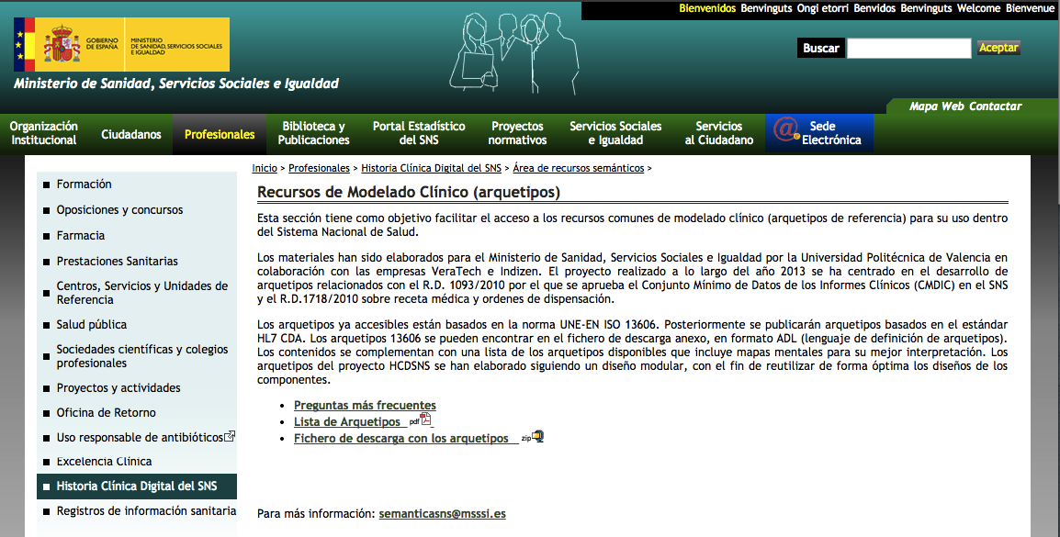
Archetypes

Slide 4
CIM repository

Slide 5
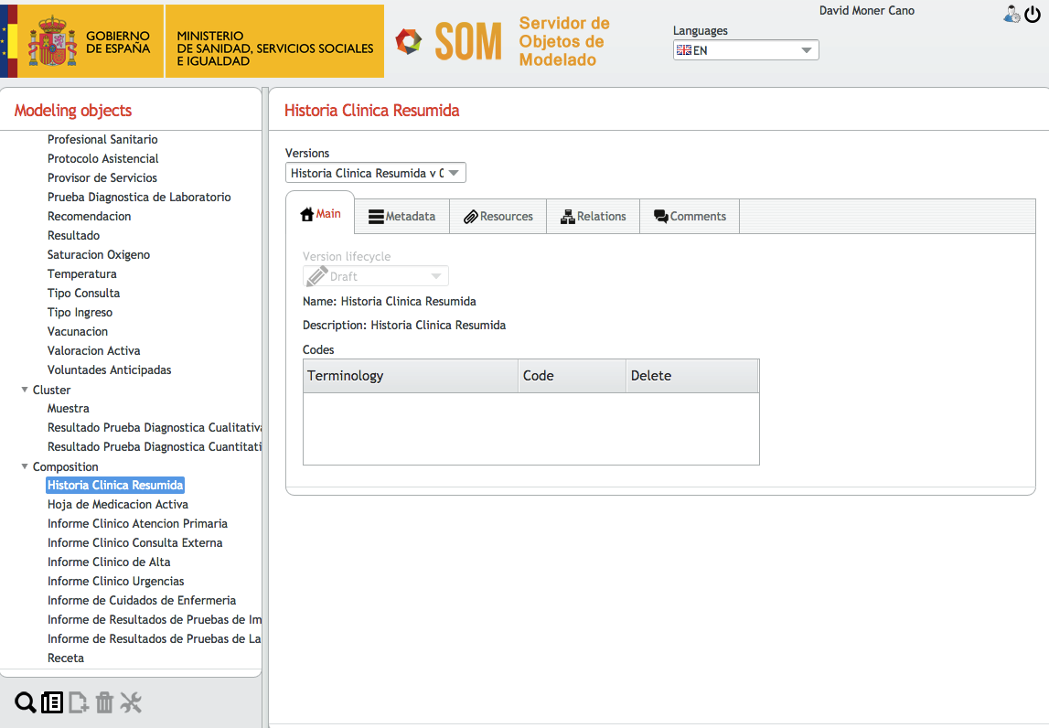

Slide 6
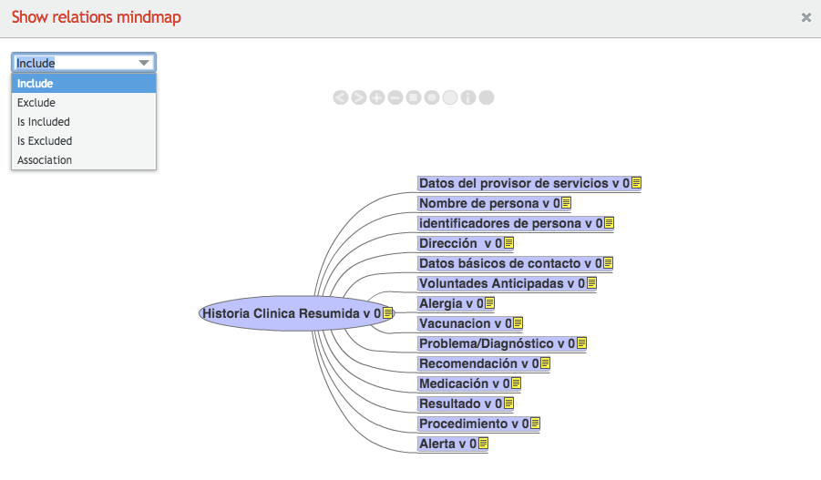

Slide 7
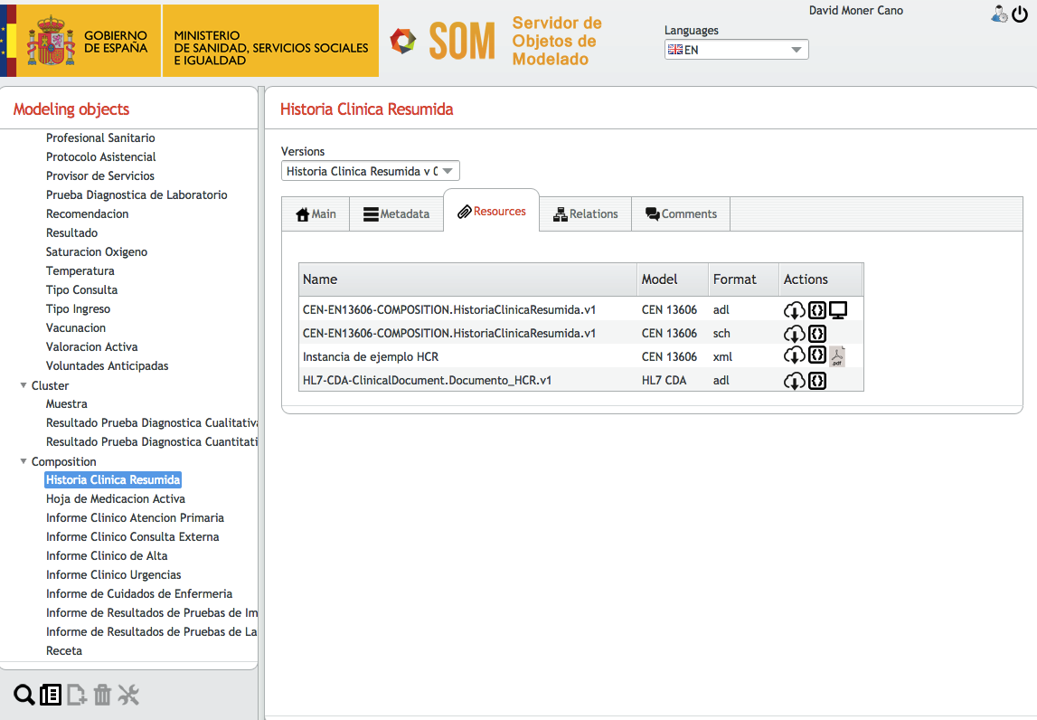

Slide 8
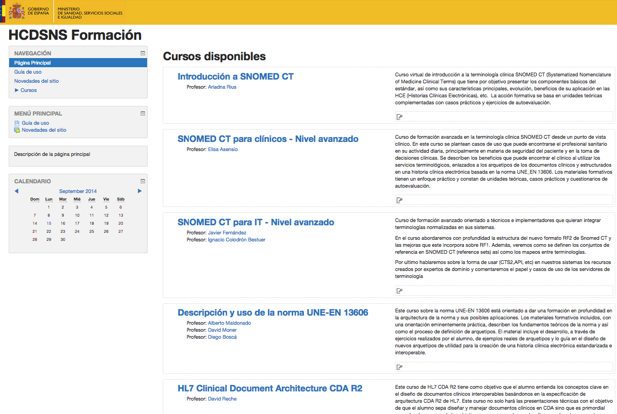
Training

Slide 9
Regional projects
Regions in process of creating archetype-based systems or with specific pilots
Madrid (regional EHR, 6.4m people)
Comunitat Valenciana (regional EHR, 5.1m people)
Castilla y León (regional EHR, 2.5m people)
Andalucía (pilot project)
Galicia (pilot project)

