Slide 1
Norwegian national governance of archetypes: an update
Silje L. Bakke
Archetype coordinator
National ICT Norway
This work is licensed under a Creative Commons Attribution-ShareAlike 4.0 International License.

Slide 2
National archetype governance
National ICT has developed and deployed a national archetype governance scheme
Three people employed
  Leader and two coordinators
  Total of two full time positions
Goals
  High quality archetypes
  Semantic interoperability through use of identical archetypes

Slide 3
  National archetype governance, cont’d
Clinical Knowledge Manager (CKM)
  http://arketyper.no
Use
  Collaborative development
  Review and approval
  Sharing

Slide 4
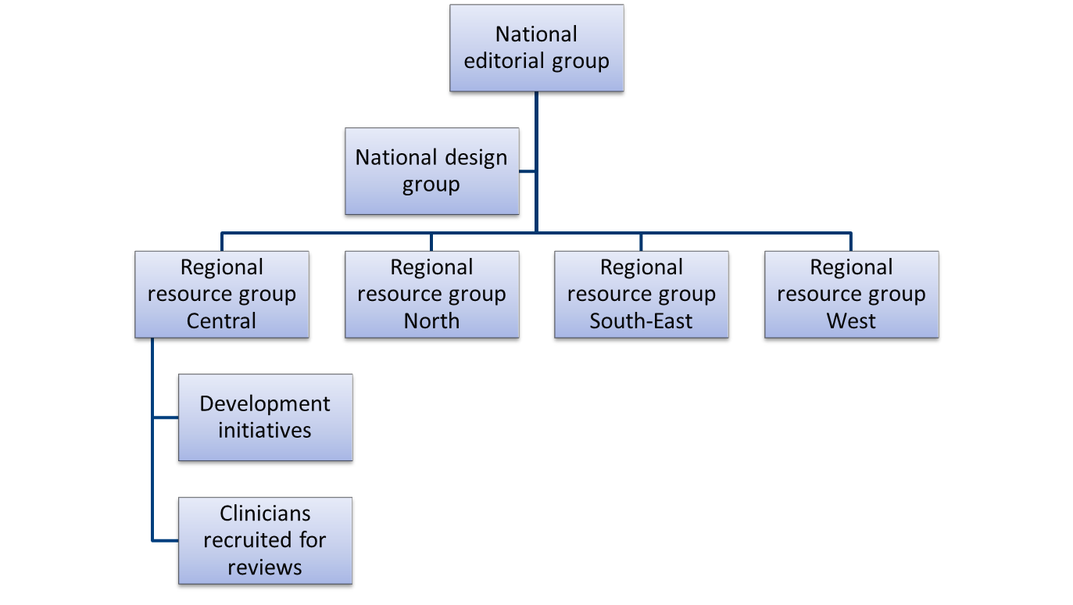
Governance organisation

Slide 5
Dev’t, review and approval
Distributed archetype development
  Local initiatives define requirements
  “Do-ocracy” – doers make the decisions
Reviews are initiated by the editorial group
  Requirements, recruiting of reviewers, CKM(!)
Approval is done by the editorial group
  If requirements are met

Slide 6
Some results and problems
Recruiting CKM users is relatively easy
However:
  Not all are active clinicians
  Some professions/ specialities are harder to recruit than others
  Not all actually respond to review invitations

Slide 7
More results and problems
Late-coming requests for structural changes means we bother clinicians with more review rounds than necessary
Probably will lead to increased dropout rate

Slide 8
Even more results (without problems?)
We’re still getting really good quality input from both clinicians and others
There have been no insurmountable disagreements (yet)
We’ve managed to approve one archetype (guess which)
  Six more on the way

Slide 9
Possible solutions
Recruiting/getting response:
  Get the regional resource groups up and running
    Closer follow up of clinicians invited to reviews
    Recruiting more clinicians to get more redundancy
  Translate at the very least the emails from the CKM
Late structural changes to archetypes:
  Get the design group up and running
    Including vendor(s)
    Do early technician/health informatician reviews prior to clinical reviews

