Slide 1
Dr Heather Leslie
MD, Clinical Modelling Lead, Ocean Informatics, Australia
Clinical Programme Lead, openEHR Foundation
Director, Global eHealth Collaborative

Slide 2
Clinician Engagement
Multiple layers
Each with different education requirements
Grassroots engagement
Participation in CKM
Reviews
Discussion
Archetype Authors/Editors– international and national – training courses, advanced workshops, ongoing mentoring
Clinical Knowledge Administrators

Slide 3
Grassroots engagement
WHO: Grassroots clinicians
WHAT: Requirements gathering
HOW: F2F workshop
Step-by-step process:
Brainstorm requirements to a mind map
Reorganise the mind map
In parallel
Identify existing archetypes
Identify new requirements - ?archetypes, templates, value sets
Create a template
Clinicians can see the information models representing their requirements
The ‘AHA’ moment
Clinicians can contribute to constraints
Output: Draft TDS/OPT for implementers
Refinement
Create new/modify existing archetypes
Archetype review rounds if needed
Template review

Slide 4
Participation in CKM
Process:
Registered, but no credentialling
Web 2.0, crowd sourcing
Transparency to mitigate ‘rogue’ activity
Participation
Reviews/Adoption
Discussions
Change requests
Propose new models
Education opportunities
Training course
Online videos
Online course
?Most have no training
Contributions
Grassroots → expert. Clinical → Technical. All welcome

Slide 5
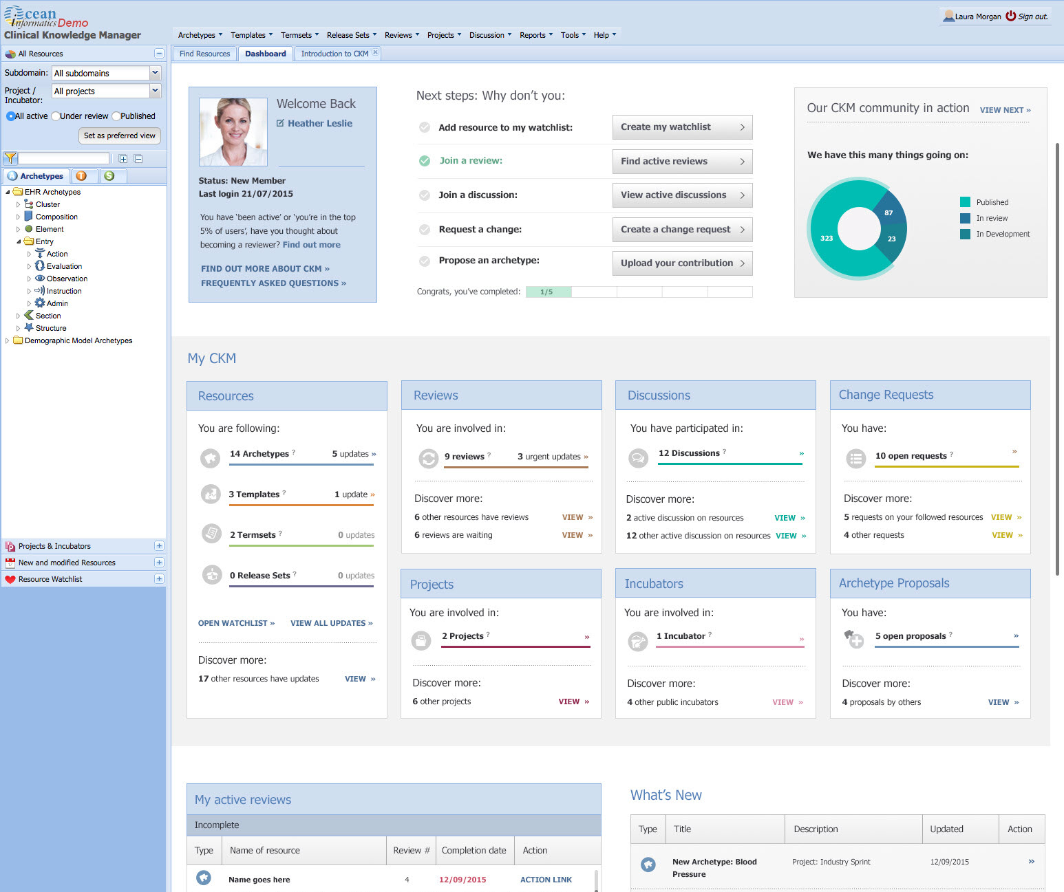

Slide 6
Authoring/editing/CKA
Anyone can build an archetype
Any archetype can be implemented
If you want highly interoperable archetypes, they have to conform
Evolving design patterns
Data structure
Nesting
Balance between terminology & information model
Metadata conventions
Naming convention
Consistency, Quality

Slide 7
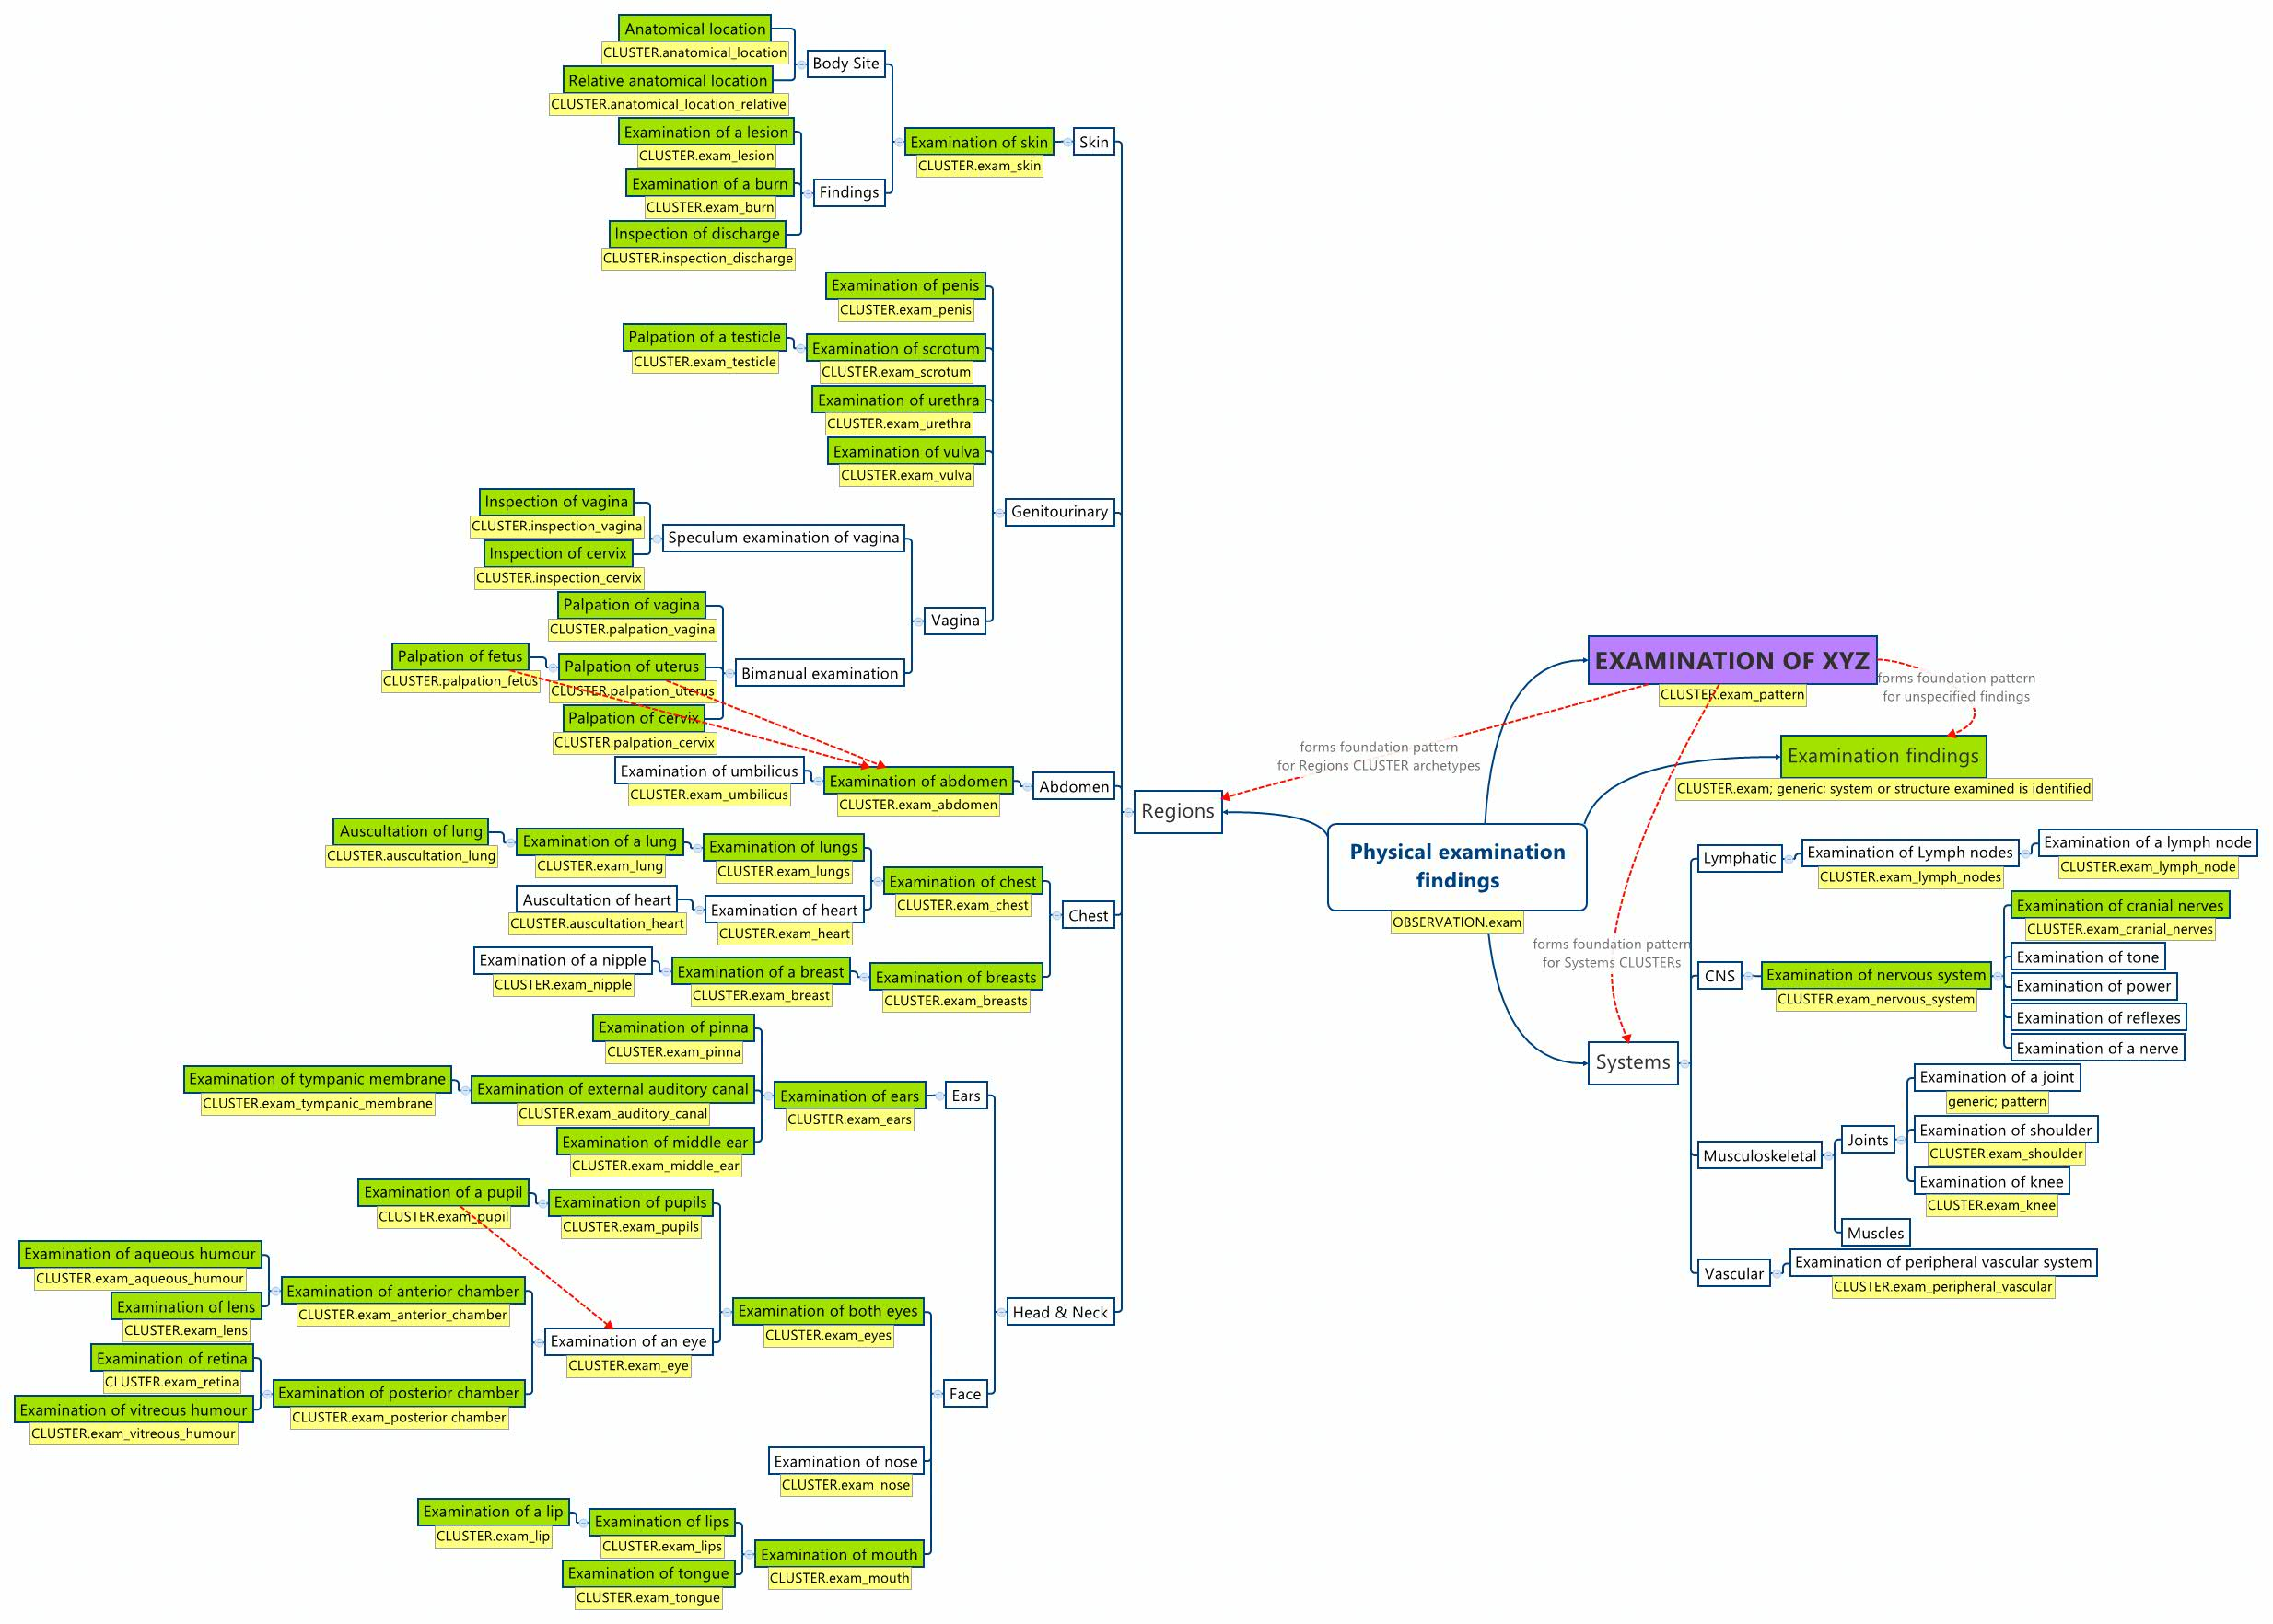

Slide 8
Authoring/editing/CKA
Opportunities
Trial & Error
Online training – commencing
Training Course – part of intro course
Advanced workshops – hands on, practical problem solving
Ongoing mentoring
Collaborating
Reverse training
Level of interoperability dictates level of training required

Slide 9
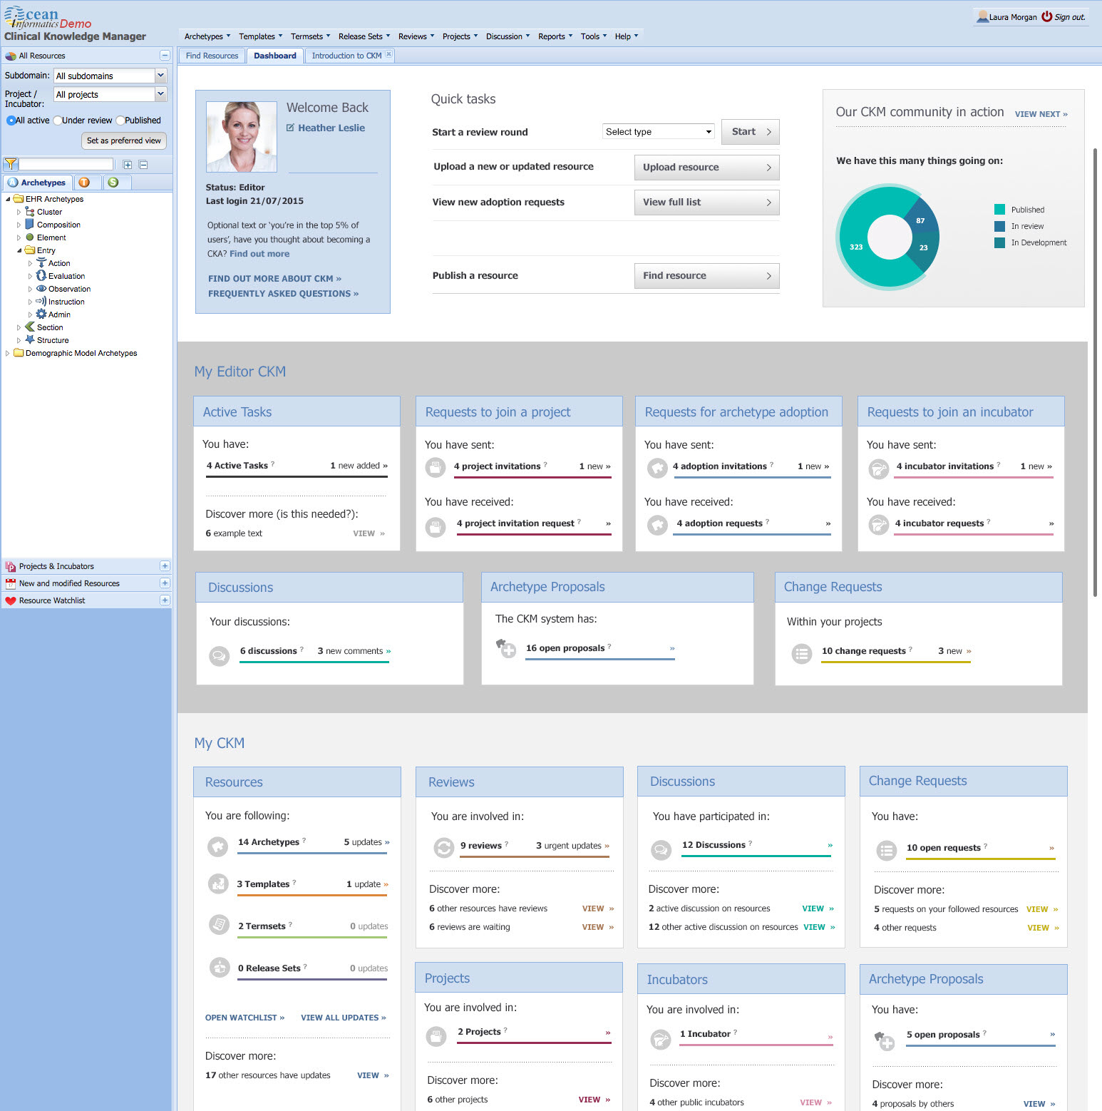

Slide 10
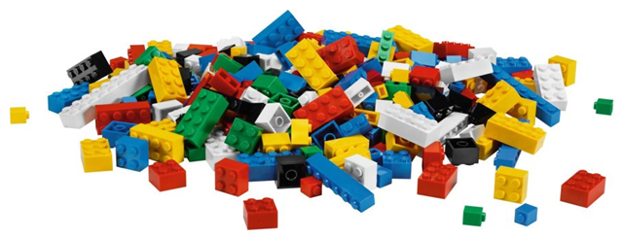
XYZ National Program
2-3 CKAs
6-8 trained archetype modellers
Ensure consistency, quality
10s-1000s of reviewers
Distributed templaters, consuming quality archetypes

