Slide 1
RES-SUS (Brazil EHR) National E-Health Architecture Jussara Rötzsch, MD, MSc Director Of OpenEHR Foundation

Slide 2
A Bit of History
Health Information Systems in use in the Public Sector since the 1970s
Data are available on www.datasus.gov.br;
DATASUS is the MoH’s Department of Informatics and provides HIT solutions for states and cities.
Vertical applications were the initial focus
More than 250 siloed systems:
HIV, Prenatal and Child Care, TB, Diabetes and others;
Two major projects sparked change, around 2000
The National Health Card Project (SUS Card)
Standards for unique IDs for individuals (including HC workers);
The National Registry of HC Providers,
Unique identifiers for HC Professionals
Relationships among procedures, HC professionals, equipment and organizations.

Slide 3
An Architecture for eHealth
HC Workers
Registries
Shared
EHR
Other…
NID
Registry
Messaging
Services
Other…
HC Facilities Registry
Indicators
Terminology
Server
Client
Registry
Interoperability Layer: Norms, Standards and Regulations
System 01
System 02
System 03
System 04
System N

Slide 4
Main Goals of an Architecture
Recognize and provide answers to wide organizational needs
Corporate, federal or state governments, large communities...
Driven by Strategic Goals
Integration
Policies, Regulations, Norms, IT Architectures, Infrastructure, HR
Organizational Resources
Infrastructure
IT Architecture
Human Resources
Independence & Liberty
Recognize and provide answers to local and specific needs
Specialties, cities, small communities...
Driven by local needs

Slide 5
Background for the Brazilian Case
Brazil has a long tradition in the use of Health Information Systems;
Several initiatives have been developed trying to make the SUS systems interoperate with each other;
PNIIS – the National Policy on Health Information and Health Informatics is in its final process of construction;
Expectation around use of eHealth as a significant strategy to support SUS has increased, in a similar way to what occurs in countries like England, Canada, New Zealand, USA and Australia, among others;
A Ministerial Order was published in 2011 selecting openEHR to be the reference model to the National EHR, SNOMED CT the national health terminology and IHE profiles to be used in the exchange of demographic and Clinical Data.
Since May 2012, DATASUS has been promoting a series of workshops on EHR Systems for SUS and the country.
It was recognized that there’s a need for a National eHealth Strategy to guide all initiatives of eHealth in Brazil

Slide 6
brazil EHR CNS, PEP (eSUS), RES Nacional e Barramento
CADSUS Web
Portal Cidadão
eSUS Hospitalar
eSUS AB
APIs
Serviços de Negócio
Impressão
UsuarioSUS
ES
Producao
Farmácia
PDQ
PIX
Health Services
Bus
Serviços Utilitários
Registries Data and Services
Persons
Registry
Healthcare
Providers
Registry
Clinical Data and Events
Repositories
Knowledge artefacts
OpenEHR archetypes and
templates
DW

Slide 7
Overview of the architecture
EHR architecture is divided in four main building blocks:
Software: corresponde aos sistemas existentes ou a desenvolver que vão alimentar e consumir dados do RES e outros serviços;
Services: Health service bus comprising the middleware and RBAC and security services to enable a safe comunication among the diverse clinical information services and acccess of secondary to the EHR, according with security privacy and consentment policies;
Registry Services: Person, Health Professional and Healthcare providers registries. Used in the middlware to cross and locate the right patient information;
Repositories:
Clinical Data Repository (EHR) – based on OpenEHR
Demografic EHR
XDS – Document Directory. Following the IHE profile. CDA R2 will be the exchange format.

Slide 8
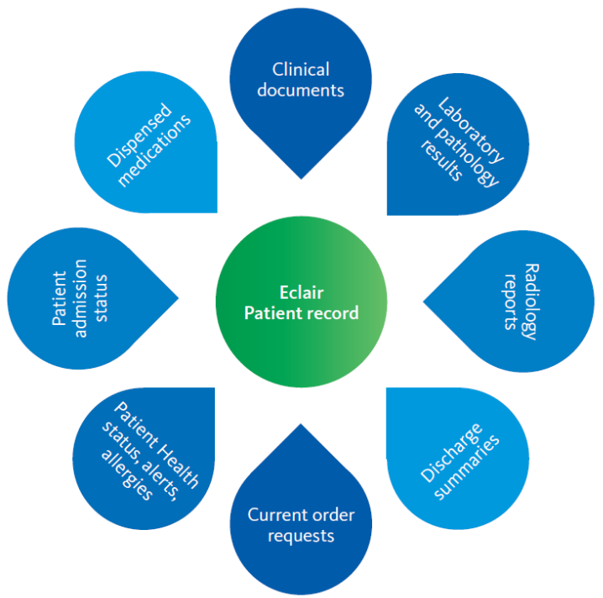
Repositório clínico
Problems and diagnoses
Medications;
Alergies and adverses reactions;
Imunizations;
Blood type;
Vital signs;
Biometric measures;
Personal and Family antecedents;
Habits and Risk Factors;
Procedures;
Lab tests;
Image tests;
Patient education;
Episodes:
Episodes – Admission data;
Episodes – Reason of Encounter;
Episodes – Present disease story;
Episodes – Main diagnosis and secondary diagnoses;
Episodes – Discharge summary;
Episodes – Clinical events summary.
E-referral
Patient’s Clinical Information

Slide 9
Example Semantic Framework – Requested medication
Requested medication encompasses:
Requested and administred medications during any clinical event:
Prescripted medication to be taken after the clinical event.
Reference archetypes:
openEHR-EHR-INSTRUCTION.medication_order-ubr.v1
openEHR-EHR-CLUSTER.chemical_description-ubr.v1
openEHR-EHR-CLUSTER.medication_amount.v1
openEHR-EHR-CLUSTER.timing.v1
openEHR-EHR-CLUSTER.medication_admin.v1
Arquétipo de referência:
openEHR-EHR-INSTRUCTION.medication_order.v1
openEHR-EHR-CLUSTER.chemical_description.v1

Slide 10
Example Semntic Framework – Requested medication(2)
Atribute | Type | Cardinality | Comments
Medication | DV_TEXT | 1..1
Code | DV_CODED_TEXT | 0..1 | Code according existing terminology. TUSS (Reimbursement Terminology)
Active principle | DV_TEXT | 0..* | ATC??? No existing
Strength per dose Unit | DV_TEXT | 0..1 | Definição da dosagem para cada princípio ativo
Form | DV _TEXT | 0..1 | Vocabulário controlado Anvisa
 | DV_TEXT | 0..1 | Posologia em texto
Dose (texto) | DV_TEXT | 0..1
Dose instruction | DV_TEXT | 0..1
Data de início | DV_DATE_TIME | 0..1
Data de fim | DV_DATE_TIME | 0..1

Slide 11
Challenges
International archetypes were changed because Brazil lacks clinical terminologies for the most business cases. (To DV-TEXT)
Data analysis is compromised by the lack of terminologies in Brazil.
A National Terminology Service is being considered to cross map the administrative terminologies that are in use.
Affiliation to IHTSDO was finally off ground because adoption to SNOMED-CT and extensions (medication) are considered value proposition
Problem list are now coded using ICD 10 na ICPC- Plus.
In many cases we are using the internal terminologies of international and NEHTA´s openEHR archetypes ( a single library of international archetypes woul be useful to projects that want to ADOPT openEHR methodology.

Slide 12
Thank you! Jussara M p Rötzsch, MD, MSc Director openEHR Foundation www.openehr.org – jussara.macedo@openehrfoundation.org +55 21 9611 7403

