Slide 1
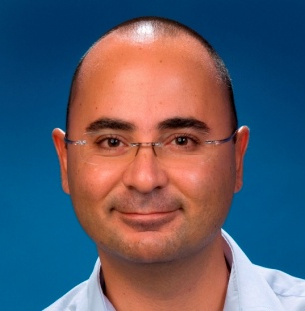
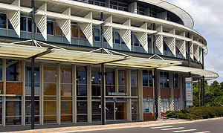
About
Koray Atalag, MD, PhD, FACHI
Medical Doctor, PhD Information Systems
Fellow of Australasian College of Health Informatics
Chair openEHR New Zealand
openEHR Localisation Program Leader
HL7 New Zealand Board Member
Health Informatics New Zealand Executive Member
ISO TC215 Working Group Member
National Institute for Health Innovation (NIHI)
The University of Auckland
Private Bag 92019, Auckland
New Zealand
Notes:
I was trained as a medical doctor with PhD in Information Systems and a Fellow of the Australasian College of Health Informatics.
My main research interests are clinical information modelling, interoperability standards and software maintainability.
I lead the openEHR Localisation Program, sit in HL7 New Zealand Board and Executive Committee of Health Informatics Association (HINZ).
Based at the University of Auckland, I am using openEHR Archetypes to create computable clinical information models.
I have co-authored the national Interoperability Reference Architecture (HISO 10040) underpinned by openEHR
I lead the technical evaluation and procurement of major health IT projects and advise the government and industry.

Slide 2
eHealth Vision
To achieve high quality health care and improve patient safety, by 2014 New Zealanders will have a core set of personal health information available electronically to them and their treatment providers regardless of the setting as they access health services.
Information will be recorded electronically
Personal health information will be available, with appropriate access, across providers
People will be more involved in the collection and use of their personal health information
Providers will have clearly defined roles when collecting, using and sharing health information
Optimise resources (time, facilities and equipment) and focus on the quality healthcare.
Notes:
2
New Zealand health IT has strong history of strategic thinking and implementation planning.
Since 2005 there has been a clear and comprehensive eHealth Plan which is still being implemented consistently to date.
The 2010 Health IT plan states the above vision and principles.

Slide 3
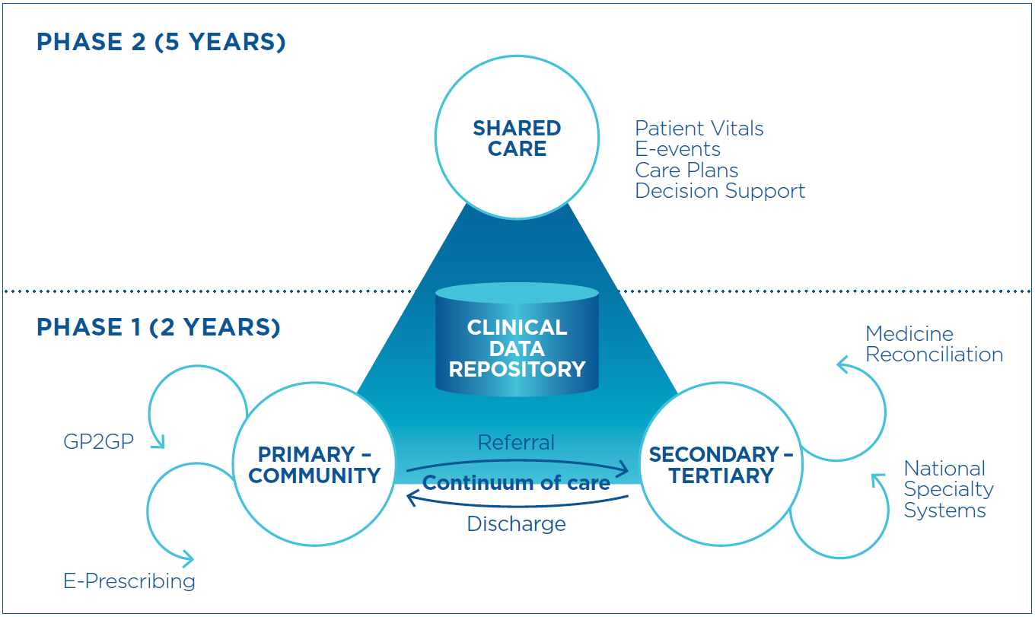
National Health IT Plan
Enabling an Integrated Healthcare Model
Notes:
This single diagram has been influential in communicating the vision and components of health IT strategy to the Sector.
We even have a PhD student who is studying the impact of this single diagram on our progress.
It consists of two phases, where we are 2 years into the second phase now.
The ultimate aim is to establish “Shared Care” which is effectively a minimally functional longitudinal EHR, not only having static but also care plans. The technical enabler is the Clinical Data Repository, in 5 regions in the country, that stores data from numerous local provider systems.
Interoperability among different systems is a necessity and has been recognised adequately in the Plan and during implementation.
The link between primary and secondary/tertiary care has been and still is the major goal. We have more success in the primary care in the past but not secondary/tertiary care is picking up.

Slide 4
Information landscape
Notes:
This is how the Ministry’s e-health programme sees the sector’s information landscape
There is certain core health information, held nationally for every person – this naturally centres on the NHI as the master for patient demographic information
Where individuals have special needs, they might have a care plan with input from a multi-disciplinary care team – the sector is working on maternity shared care, Well Child (Plunket etc), and long term conditions shared care records, as priorities
R-CDRs store objective clinical records such as test results, transfer of care documents, and perhaps also medications lists
These information resources are available to the many types of system used at point-of-service

Slide 5
HISO standards development
Notes:
What standards do we need to reach the 2014 goal?
Of these, HISO 10040 is an interim standard (awaiting trial implementation)
NIHI is currently reviewing 10041 suite of main clinical information types based on the content model

Slide 6
HISO 10040 Health Information Exchange
10040.1
R-CDRs
XDS
10040.2
CCR
SNOMED CT
Archetypes
10040.3
Documents
CDA
Notes:
These are the three building blocks – or pillars – of the HISO 10040 series that embodies the central ideas of the Reference Architecture for Interoperability
10040.1 is about regional CDRs and transport
10040.2 is about a content model for information exchange, shaped by the generic information model provided by CCR, with SNOMED as the default terminology, and openEHR archetypes as the chief means of representation
10040.3 is about CDA structured documents as the common currency of exchange – not every single transaction type, but the patient information-laden ones

Slide 7
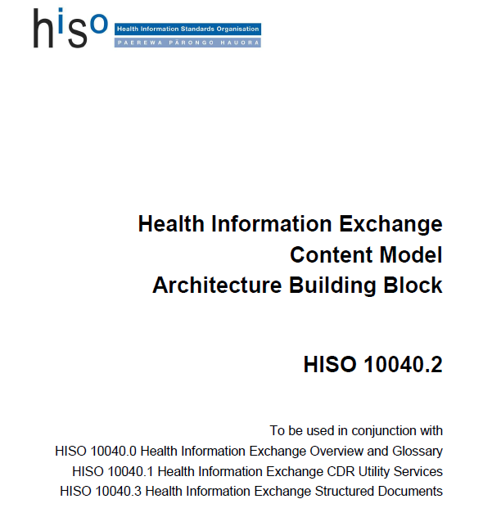
Notes:
Published by HISO (2012); Part of the Reference Architecture for Interoperability
“To create a uniform model of health information to be reused by different eHealth Projects involving HIE”
Consistent, Extensible, Interoperable and Future-Proof Data
We will work with Australia and share their Archetype repository as health systems and culture is very similar.

Slide 8
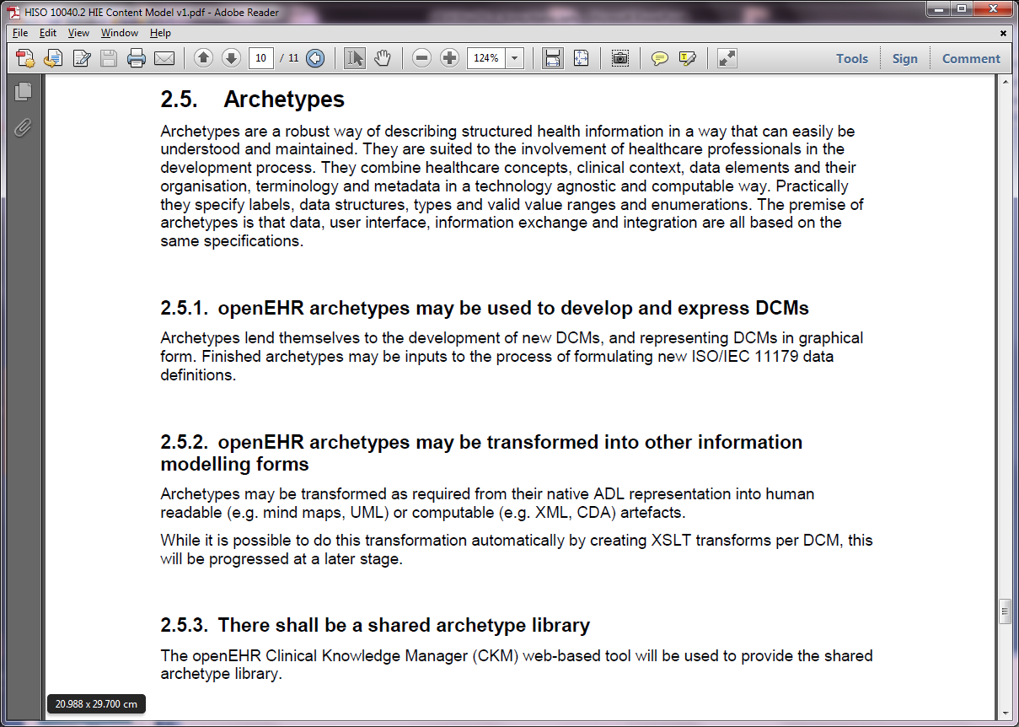

Slide 9
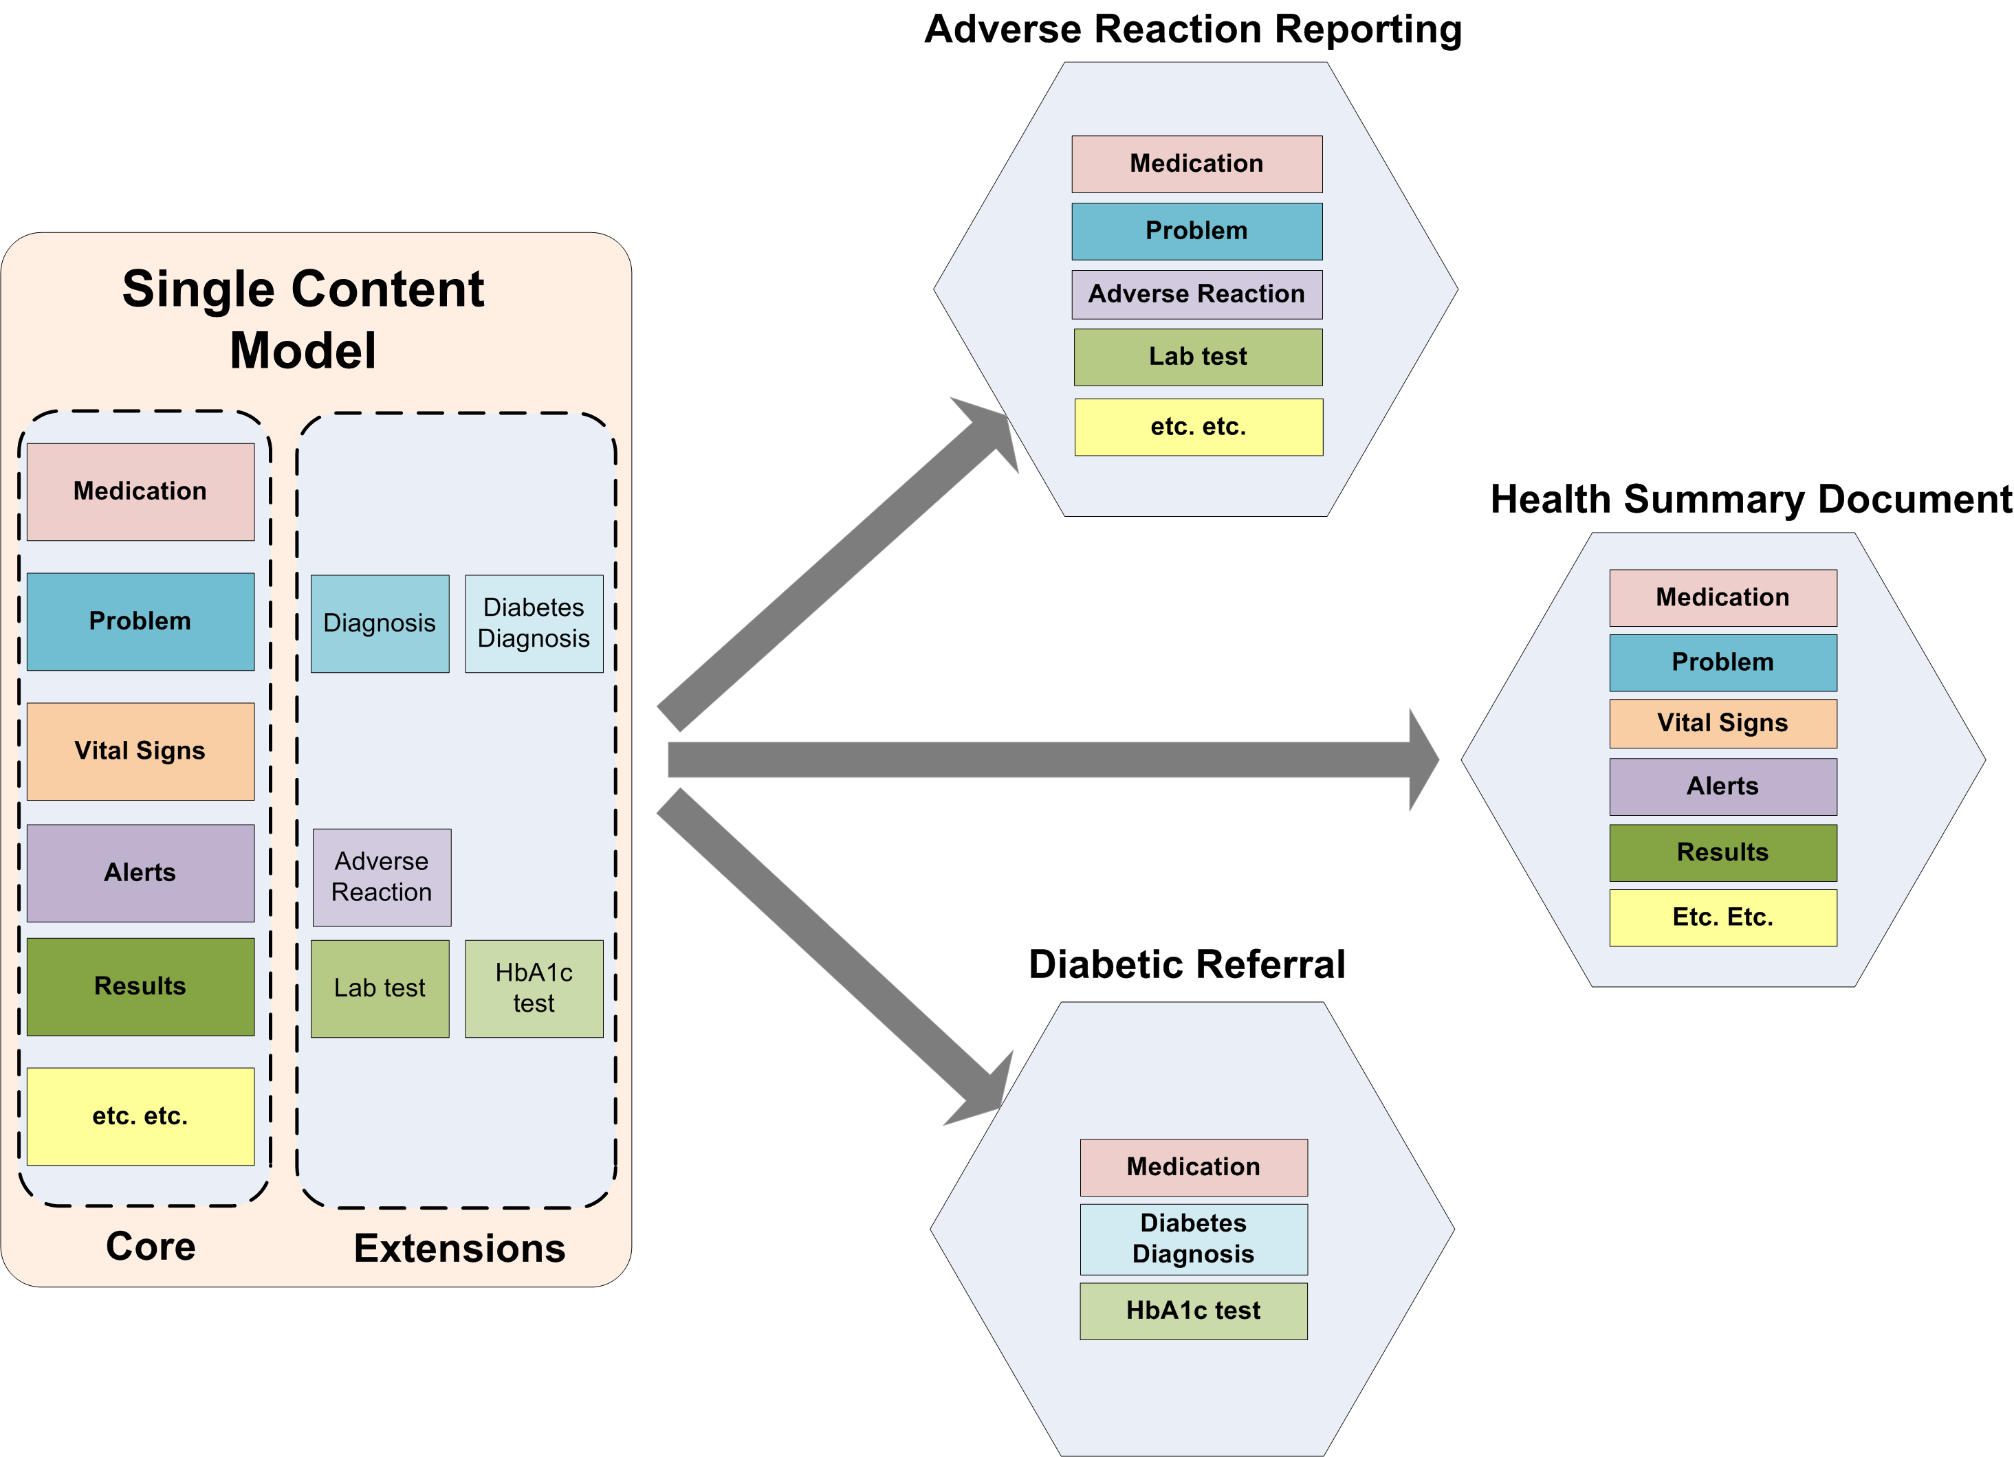
Usage of the Content Model
Notes:
Definition of health information in each use case (different CDA documents or using Web services based exchange) comes from the same library.
With Archetype specialisation all data collected using definitions of different granularities are semantically compatible.
For example a query retrieving all Lab Tests (not specifically HbA1c) will also fetch all specialised versions of Lab Tests.

Slide 10
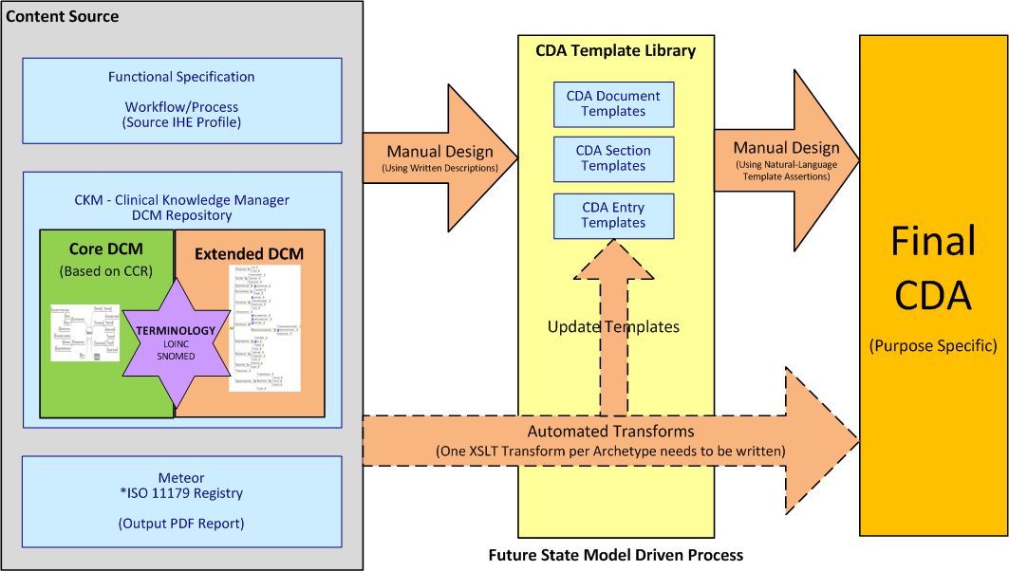
Creating CDA Payload
Notes:
CDA definitions for messaging is not a starting point but an end point.
The source of truth for health information definition is with the Content Model
It is possible to create CDA definitions based on specific use cases using automatic or semi-automatic XSL transforms.

Slide 11
Exploiting Content Model for Secondary Use
Notes:
A significant opportunity arises for secondary use in this scheme by the use of a data repository that can natively persist and query standardised datasets. Since all health information in transit in various formats (e.g. HL7) within a standard message (payload) conforms to the Content Model, all data persisted in this repository can safely be linked, aggregated and analysed.

Slide 12
GastrOS
Maintaining software in healthcare is hard!
Real world experience: endoscopy reporting application
Almost entirely driven by MST – standard domain terminology (Minimal Standard Terminology for Digestive Endoscopy – version 2)
Essence of problem:
Biomedical ‘stuff’ is volatile
hardcoding domain knowledge into sofware (code + DB)
New Model Driven Development – using openEHR
Archetype modelling + Defined GUI directives
Extended openEHR.NET library (Ocean Informatics)
Formal comparative evaluation of the ‘old’ and ‘new’ system
ALL Open Source ☺ http://gastros.codeplex.com http://openehr.codeplex.com

Slide 13
Research Questions
Is openEHR implementable at all? Feasible? (for our specific requirements)
How to create usable GUI?
Is it bad to hardcode domain knowledge into software (code + DB)
Can software evolve without (significant) techy intervention? To what extent?
Any other challenges?

Slide 14
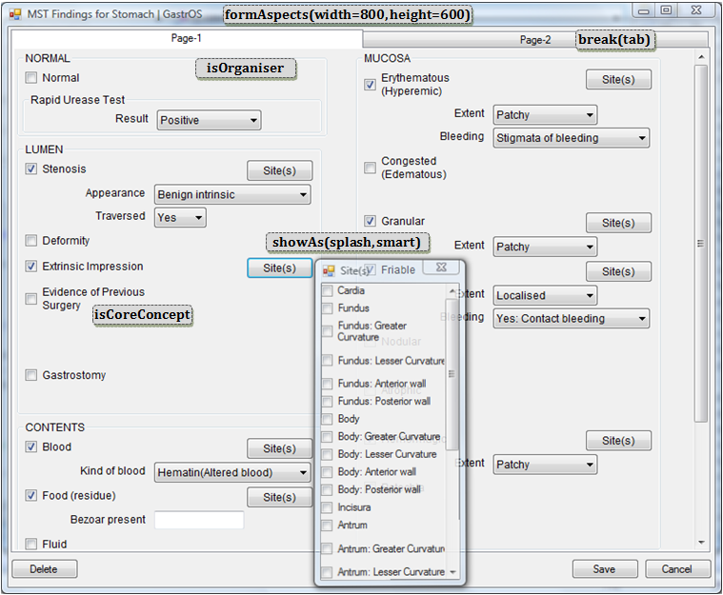

Slide 15
Conclusions
Is openEHR implementable at all? Feasible? (for our specific requirements) ➔ YES
How to create usable GUI? ➔ Described
Is it bad to hardcode domain knowledge into software (code + DB) ➔ DEFINITELY
Can software evolve without (significant) techy intervention? To what extent? ➔ Cautious Yes
Any other challenges? ➔ need more time!!!

