Slide 1
openEHR in Australia

Slide 2
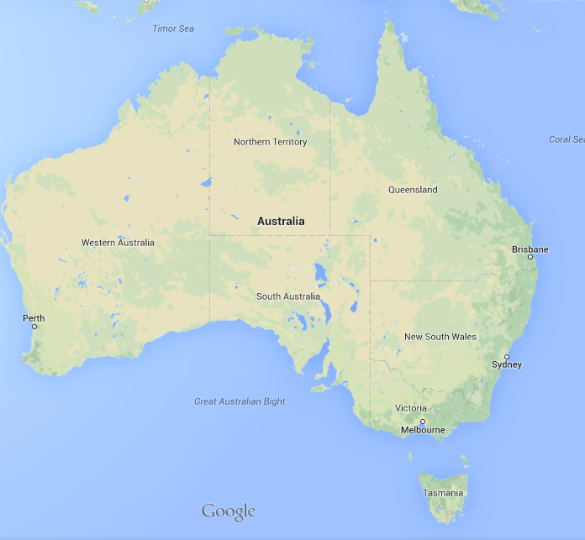
7,692,000 km²
43,094 km²

Slide 3
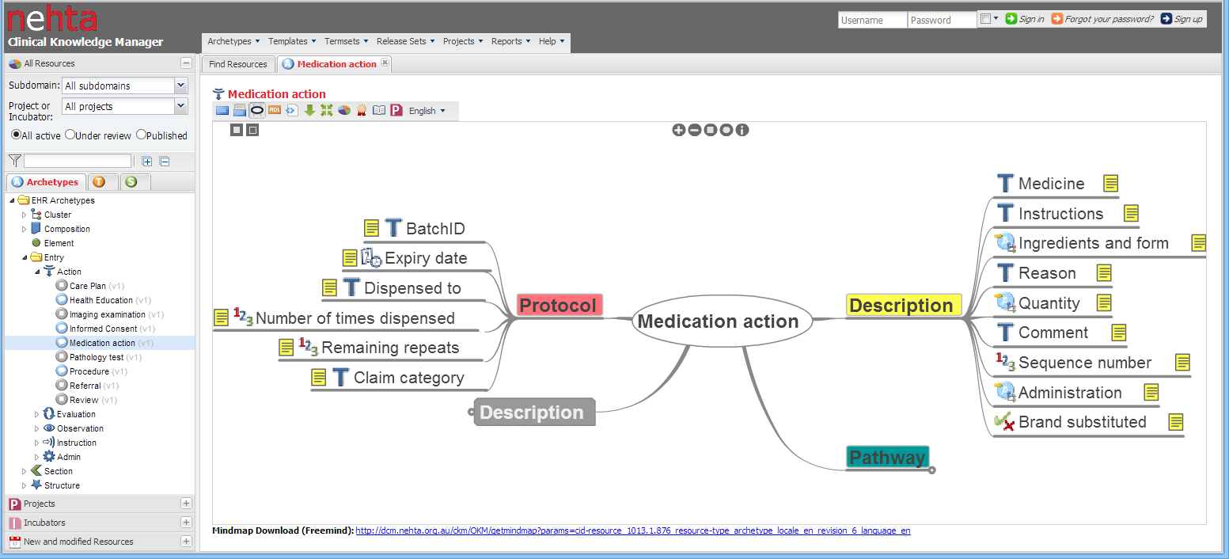
NEHTA
=
National
eHealth
Transition
Authority
National EHR
Standards for sharing information
NEHTA tool chain
Northern Territory Health
Notes:
DCMs

Slide 4
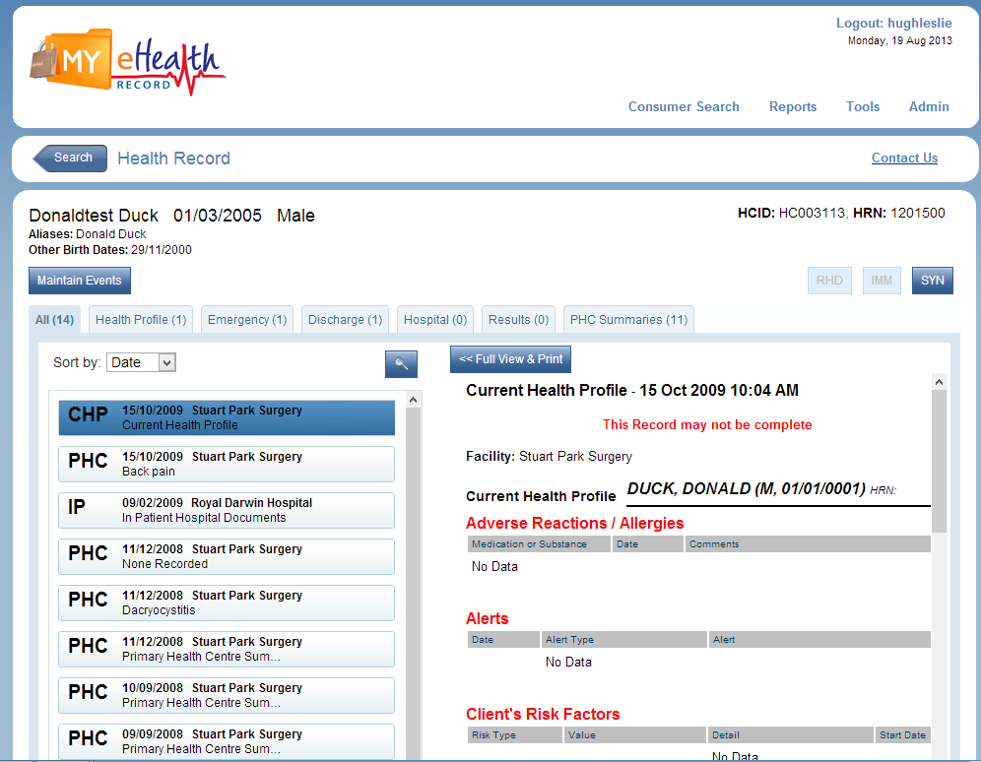
Northern Territory
MeHR
Notes:
DCMs

Slide 5
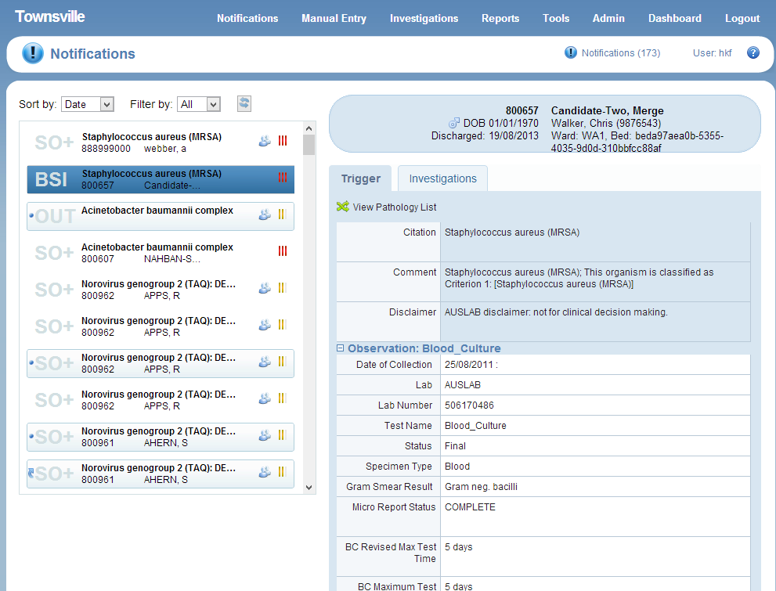
Queensland Health
Infection Control
22 public hospitals
140+ facilities
Single instance
State wide reporting
40,000 HL7v2 microbiology messages per day
30,000 HL7v2 ADT messages for the state per day
Notes:
40,000 HL7v2 microbiology messages being processed every day
All ADT messages from entire state

Slide 6
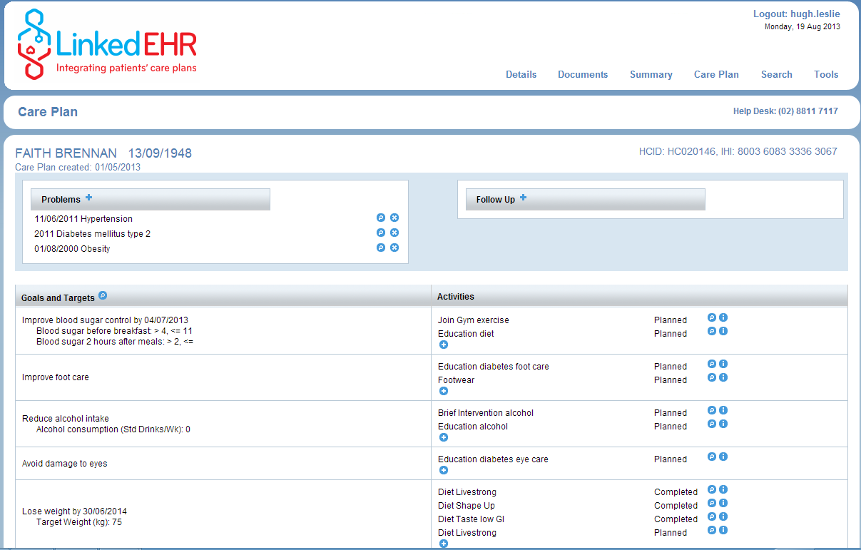
Medicare local
Care planning
WentWest ML in
Western Sydney

