Slide 1
The openehr methodology
Clinician-driven Clinical Model Development
Dr Heather Leslie

Slide 2
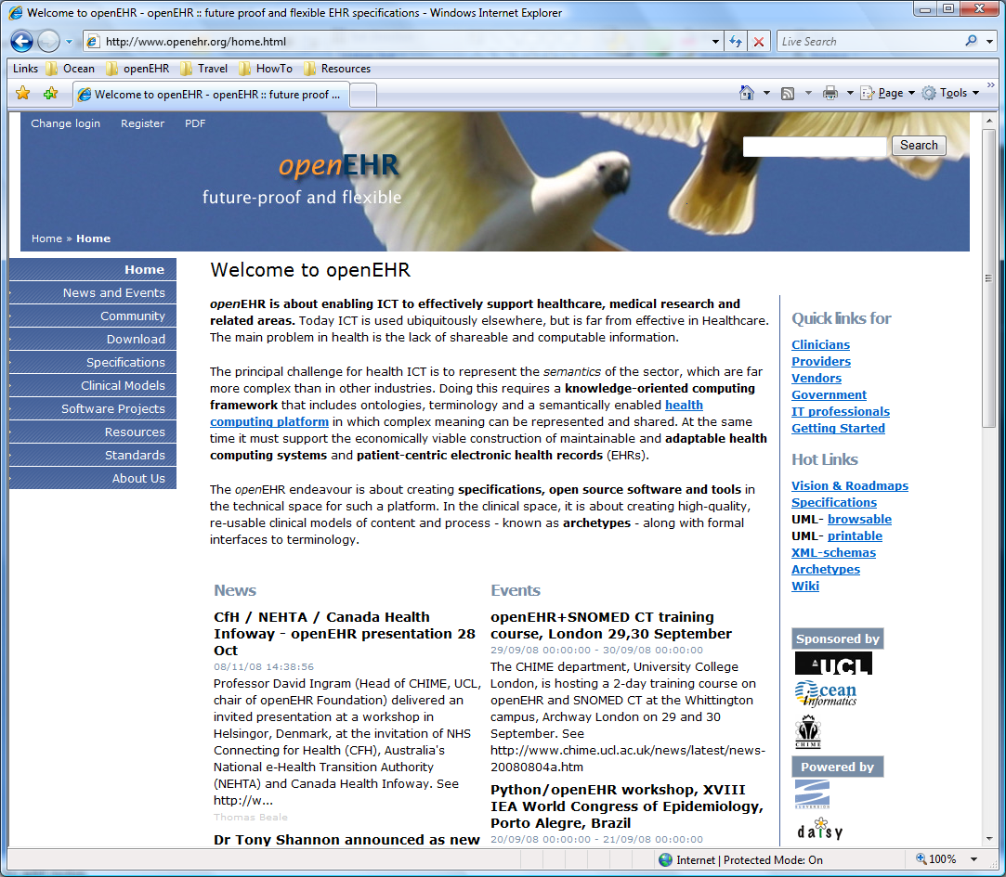
What is openEHR?
The openEHR Foundation is a non-profit established in 2001 – www.openEHR.org
Open source specifications for a logical EHR architecture
Based on 18+ years of international implementation experience including Good European Health Record Project
Superset of ISO/CEN 13606 EHR standard
Engineering paradigm
Separation of clinical and technical concerns
International Community

Slide 3
“Healthcare's Big Problem With Little Data”
Gartner’s hype cycle: “Big Data” heading toward the “Peak of Inflated Expectations”
“In the meantime, however, ”little data” in healthcare continues to give us all peptic ulcers”
“Clinical data at the unit level is chaotic and dysfunctional because it’s not easily transferable or usable outside of the system that first created it. In a world of competing financial interests and an increasingly mobile population – every patient encounter represents an opportunity for technology vendors to lock-in providers.”
“Historically, the crutch that many software vendors have relied on is the format of the data itself.”
http://www.forbes.com/sites/danmunro/2013/04/28/big-problem-with-little-data/ - April 28, 2013

Slide 4
Clinical diversity
Variety of data represented
Free-text vs Structured
Normal statements
“Nil significant”, “NAD”
Graphical
Fractal nature of medicine
Different clinicians:
Prefer different approaches
Need different levels of detail
Need to record/exchange information on a per patient basis
MYTH: “One size fits all”
Image – eg homunculus
Multimedia
Diagram, video, ECG wave
Questionnaires, checklists
Notes:
Need for clinical diversity is underrated. EHR systems corral clinicians into certain types of recording etc, but for safety we need more diverse ways for clinicians to record what they need for patient care, and also to ensure that what is exchanged is appropriate for the patient and their circumstances. A ‘one size fits all’ coument approach to emergency summaries or messages can be potientially unsafe. Elderly, pregnancy, chronic disease, paediatrics are extremely common examples where there are specific additional requirements needed to summary data sets

Slide 5
Clinician-driven health data
ORTHOGONAL APPROACH
→ Longer-term viewpoint
Standardised clinical content definitions
Notes:
What if approach the problem from a different direction, where we make the focus of EHR development the clinical knowledge, the clinical content of an EHR?

Slide 6
Clinician-driven health data
Computable, standardised clinical data definitions/models
Standardised clinical content definitions
Reference Model
Notes:
Underpin the clinical content with a Reference Model to create computable clinical data models.

Slide 7
Clinician-driven EHRs
Decision-Support
Code Skeletons
UI Forms
Data Sets
Computable, standardised clinical data definitions/models
Standardised clinical content definitions
Reference Model
XML Schemas
Messages
Terminology Mappings/ Subsets
Semantic Queries
HTML Display
Notes:
Output of computable models are numerous, generated from the same source knowledge models. Includes ability for message content to be drawn directly from the EHR data etc.

Slide 8
openEHR artefact ecosystem
Decision-Support
Code Skeletons
UI Forms
openEHR Clinical content models
Data Sets
openEHR Reference Model
Archetypes
Templates
XML Schemas
Messages
Terminology Mappings/ Subsets
Semantic Queries
HTML Display
Acknowledgements: Hugh Leslie, Thomas Beale
Notes:
In the openEHR space, the knowledge models are archetypes and templates.

Slide 9
Archetypes & Templates
Are ‘agents for change’
Require a change of mindset
Require upfront planning & coordination
Not more time
Remember re-use+++
REQUIRE CLINICIAN LEADERSHIP & ENGAGEMENT
Ensure quality of clinical data
Warrant data is safe & ‘fit for purpose’
Fulfils quality remit for professional clinical colleges
Notes:
Time will be required to develop the core content models in the first instance, but not more than is required for each current message negotiation, and when these models are increasingly re-used, they will accelerate modelling of complex model such as templates for clinical use cases

Slide 10
openEHR knowledge artefacts
Archetype
Template
Foundation building blocks
= Structured, computable specification for one single clinical concept
Maximal data set
Universal use-case
Design once, high re-use
10 to save a life; max <?2000
Tightly governed
Terminology: bindings to data element names
Use-case specific:
Message, Document, Clinical consultation or Report
= Aggregation of archetypes; constrained to clinical relevant
As many as needed
Less need for governance
Terminology: context-appropriate value sets

Slide 11
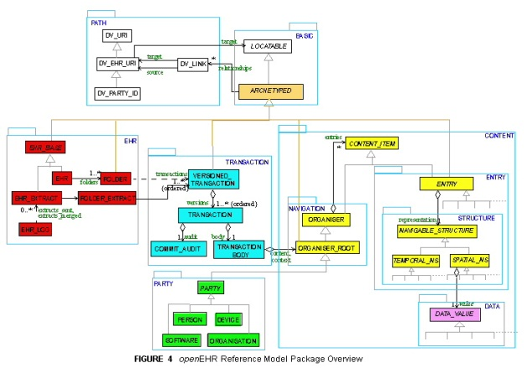
openEHR two level modelling
Templates
Archetypes
Archetypes
Archetypes
CLINICAL
TECHNICAL
Software is built independently of the content
Notes:
Separation of the clinical and technical concerns – archetypes & templates are built by clinicians independently of the software. Engineers can build the software without need for upfront understanding the content that will be contained within the EHR.

Slide 12
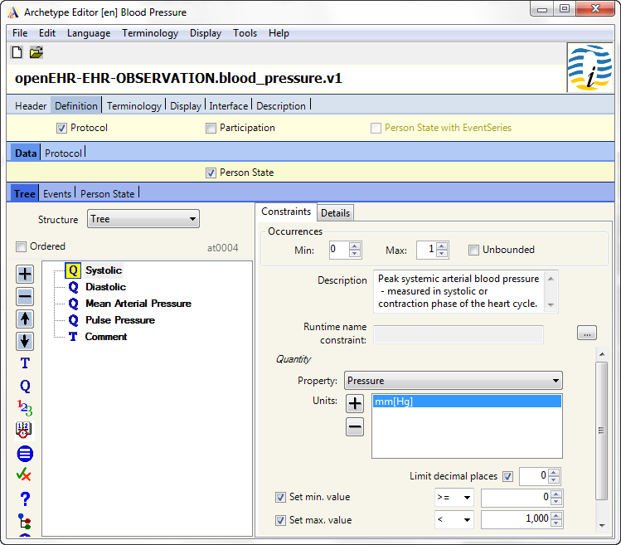
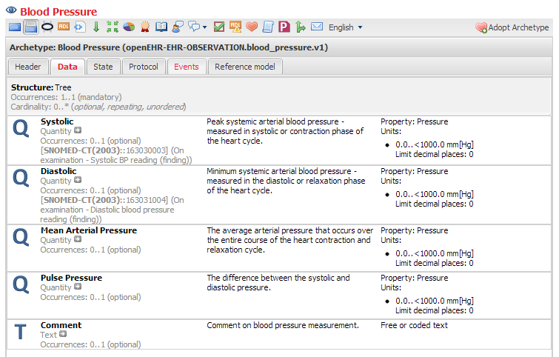
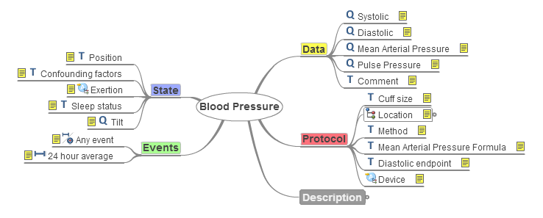

Slide 13
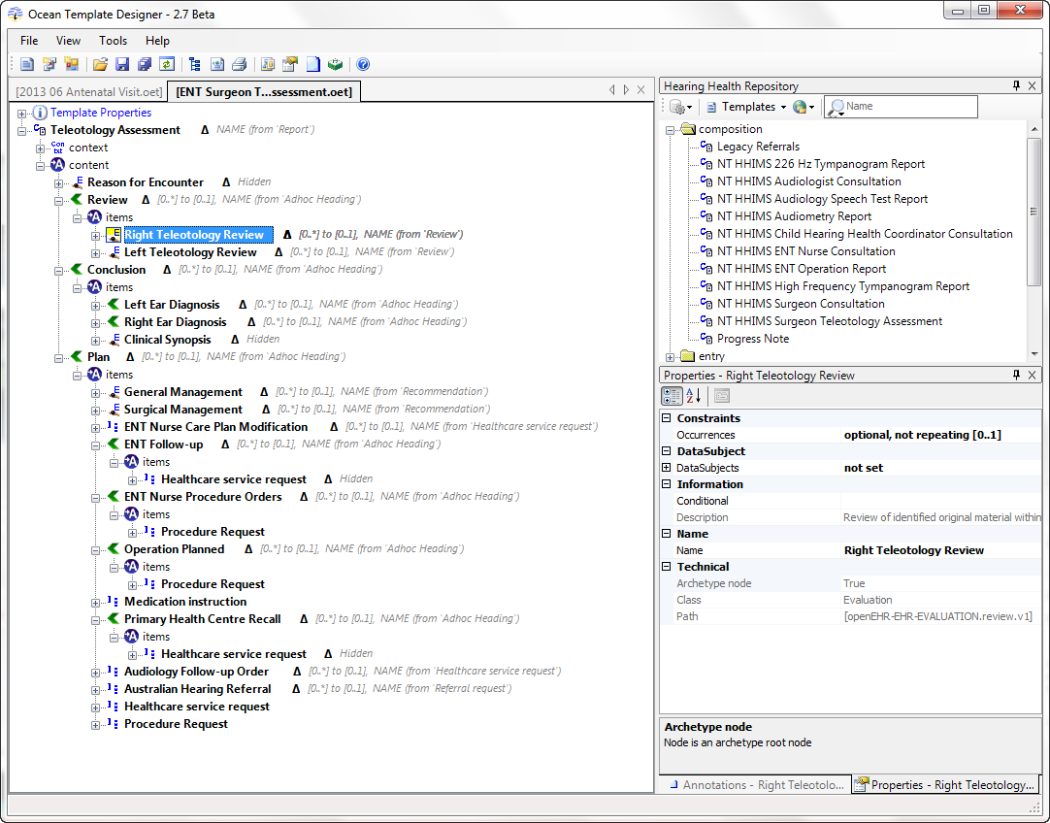

Slide 14
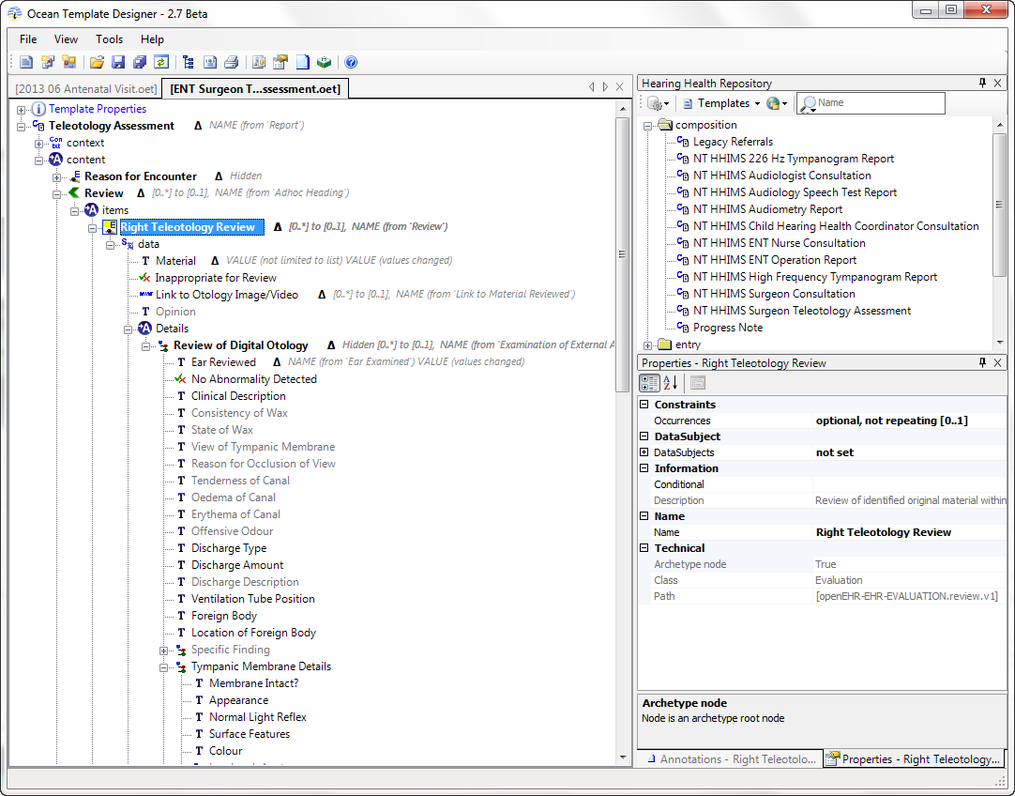

Slide 15
Archetypes Re-use
Archetypes
Diabetic checkup
Antenatal visit
Issue
Tingling feet
Feeling tired
Back pain
Weight
66 kg
76 kg
BP
102/64 mmHg
124/92
HbA1c
7.5%
142/min
FH
Excellent control
Assess
NAD, see 4/52
Template 1
Template 2

Slide 16
‘The openEHR Methodology’
Clinician-driven:
Requirements gathering
Model development
Archetypes
Templates
(Terminology RefSets)
Model verification
Governance
Publication
Endorsement/Approval
Maintenance
Distribution
Clinician Engagement

Slide 17
Typical EHR methodology
Requirements gathering
Software Development
User Interface/
Workflow tweaking
Clinicians +
Informaticians 0
Engineers ++
Clinicians 0
Informaticians 0
Engineers ++
Clinicians +
Informaticians 0
Engineers ++
Clinicians <reluctantly> allowed to participate

Slide 18
Typical openEHR methodology
Clinicians ++, Informaticians ++, Engineers +
Clinicians ++, Informaticians ++, Engineers +
Requirements gathering
Model Development & Verification
User Interface/
Workflow tweaking
Software Development
Clinicians 0, Informaticians +, Engineers ++
Clinicians actively participating

Slide 19
Traditional Requirements gathering
Identify:
Documents/Forms
Existing systems
Etc
Direct Clinician Engagement not easy
Usually a Clinician Interrogation -> Engineer Interpretation process
Success depends on the ‘right’ questions being asked by engineers
High risk of misunderstandings
No method for Clinician confirmation/validation

Slide 20
openEHR Requirements gathering
No rocket science:
Documents/Forms
Existing systems
Etc
Direct Clinician Engagement:
Health Informatician-led
Re-use existing clinician-verified models as starting point
Can develop templates in real time
Clinician buy-in
Minimise F2F meetings – $$$/opportunity cost
<Nothing new here!>
<New & exciting!>

Slide 21
Specification Development
Archetypes
Development/Re-use
Asynchronous, online reviews → clinician verification
Terminology RefSets
Development/Re-use
Asynchronous, online reviews → clinician verification
Templates
Development
Asynchronous, online reviews → clinician verification
Software Engineers

Slide 22
2 Practical Approaches
Hearing Health – 90 % virtual
RMP On-call – Initial F2F, then virtual
Identify existing forms/specifications
Mindmap concepts and ‘documents’
Developed by informaticians/clinical expert
Archetypes
Build
Clinical Review
Templates
Build
Clinical Review
2 day F2F Workshop
Identify requirements
Data
Workflow
‘Live’ Documentation
Mindmap
Template development
Reuse existing Archetypes
Constrain for use-case
Return home
Archetypes
Build new
Clinical Review
Update Templates with new Archetypes
Clinical Review

Slide 23
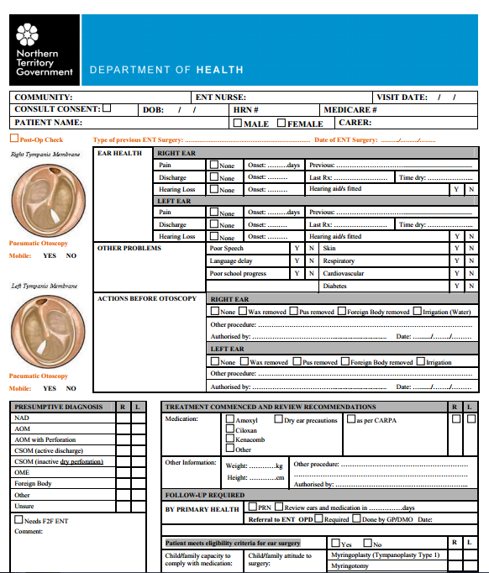
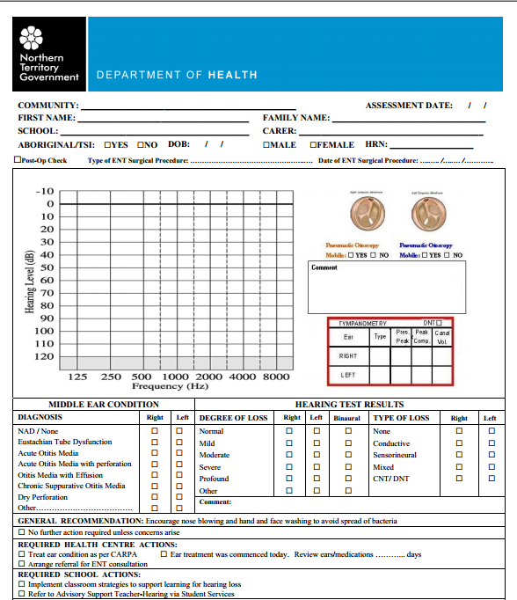
Hearing Health Reqts – Phase 2

Slide 24
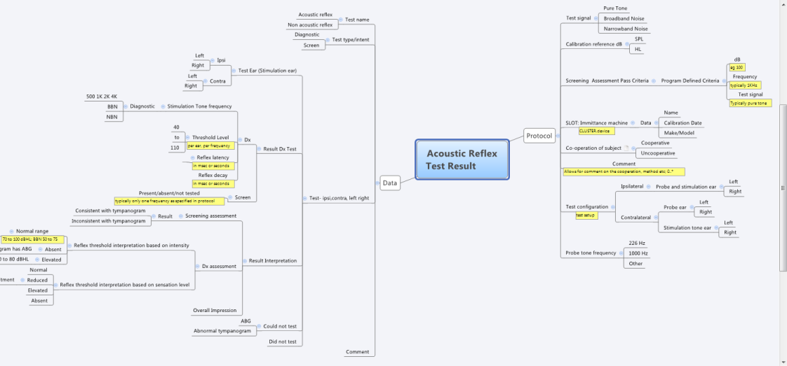
Hearing Health Reqts – Phase 1
Estimate: 85% re-use

Slide 25
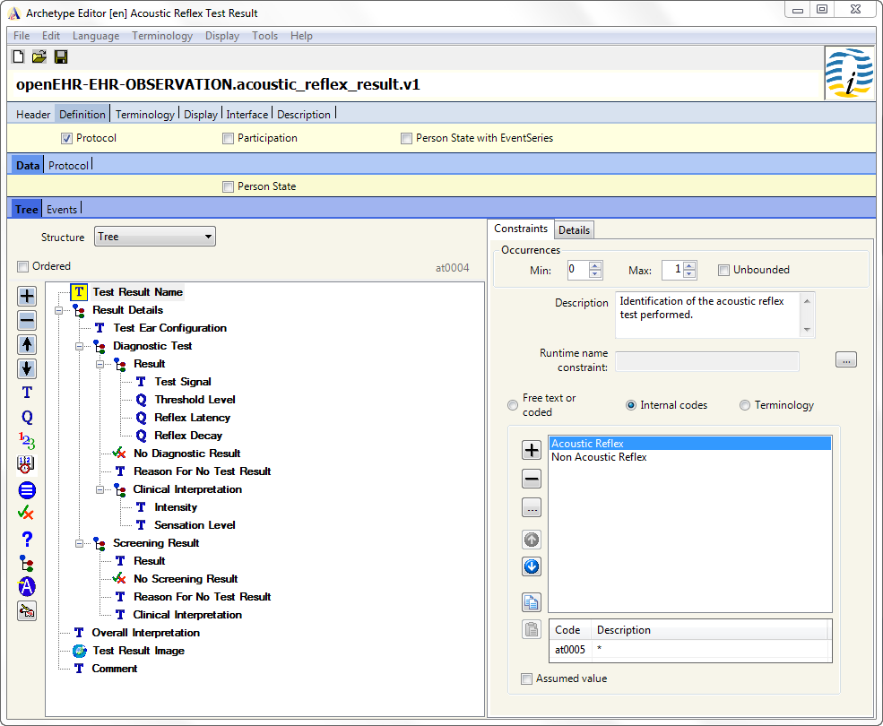

Slide 27
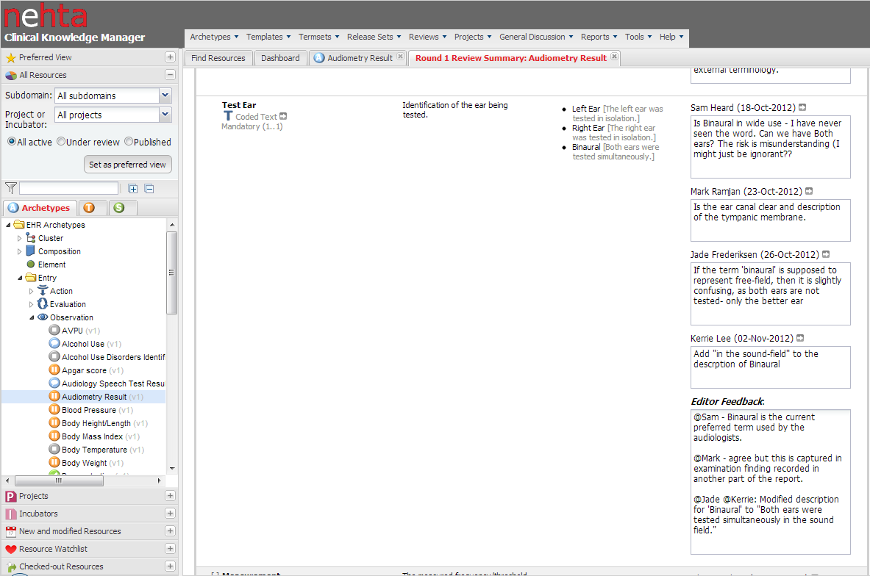
Archetype Review

Slide 28
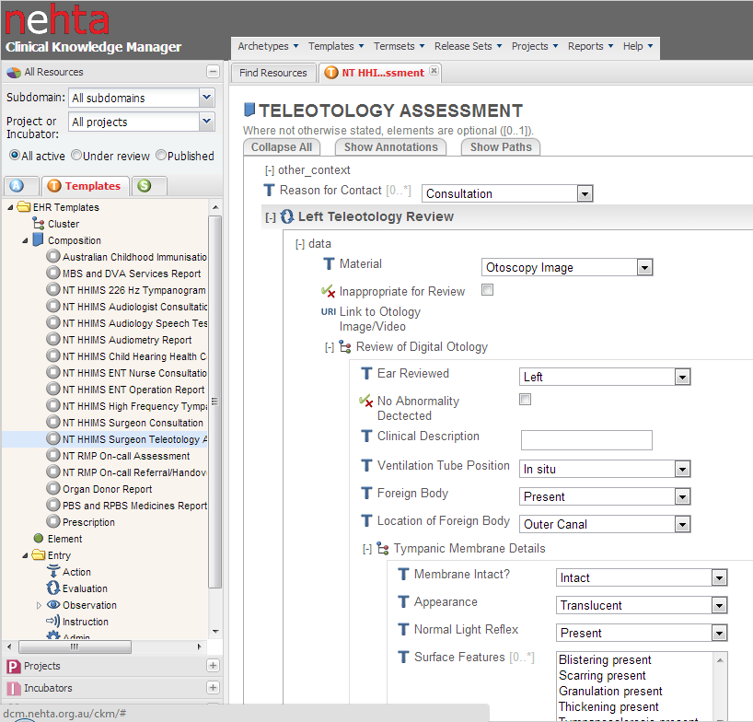
Template Display/Review

Slide 29
RMP On Call
Remote doctors in Darwin/Alice Springs supporting ‘on the ground’ clinicians
Manage major events in the remote communities
Need retrieval by RFDS/Careflight?
Complex process that varies depending on:
Who is available locally
The risk to the person and professionals
The means of transport available
The make up of the evacuation team

Slide 30
RMP Requirements
2 Day Workshop -> multiple mind maps as ‘live’ evolving documentation of requirements
Identify Templates required
Identify Concepts/ Archetypes required
Notes:
This was the mindmap that captured the discussions and was the basis for the templates. We used it as a live document that evolved to capture the discussions as they progressed. Then used it as the basis of determining each concept/archetype and templates.

Slide 31
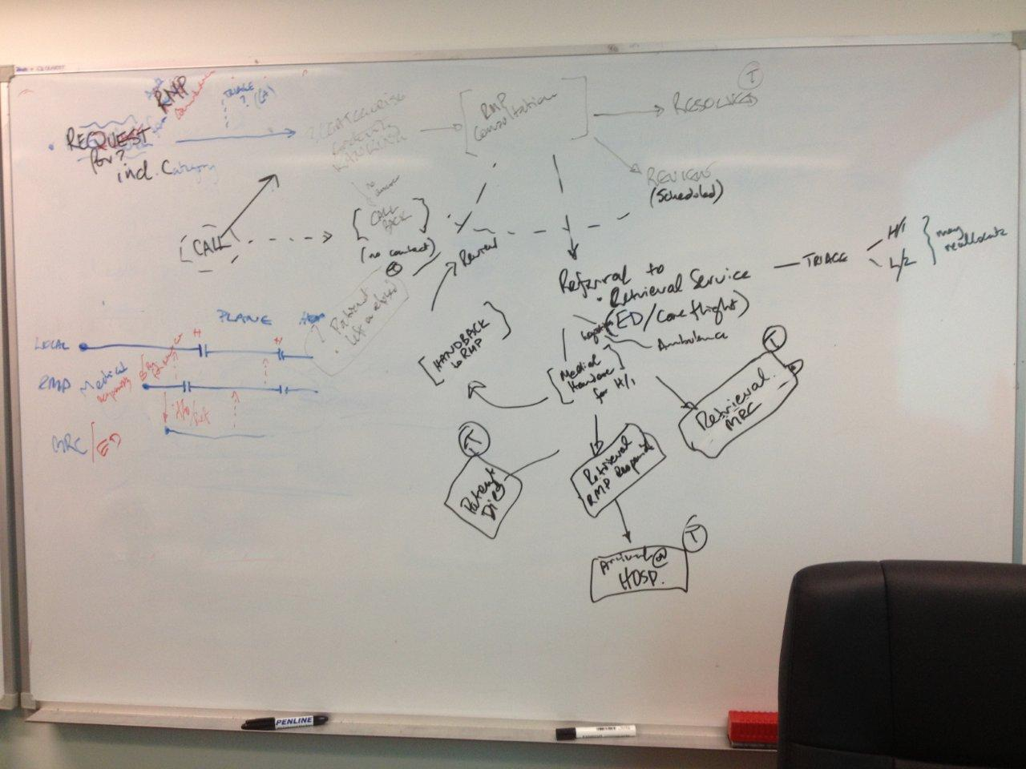
RMP Workflow
Notes:
Photos taken during the workshop as we documented the processes

Slide 32
RMP live Workshop Template
Template created during the workshop in parallel with the mind map
Clinician engagement +++
Technical specifications created:
Driven by direct clinician input and validation when re-using existing archetypes
Identify gaps. Resolve by:
modification of existing archetypes, OR
Creation of new archetype
Notes:
Template built in parallel to the mindmap using the existing archetypes and identifying those that need modification and new ones to be created.

Slide 33
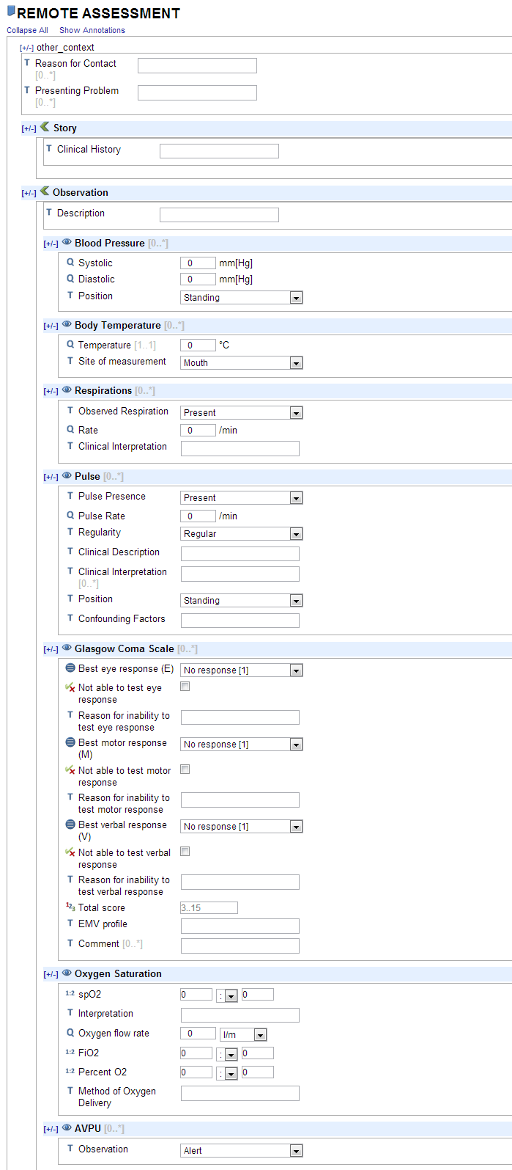
CKM template for Clinician review
3 Templates Produced:
RMP Assessment
Clinical Summary
Referral
Notes:
The ‘clinician-friendly’, non-technical view of the template for content validation. This is deliberately simplistic and ‘ugly’ and avoiding any notion of workflow or screens to ensure the validation process focusses as much as possible on the content alone.

Slide 34
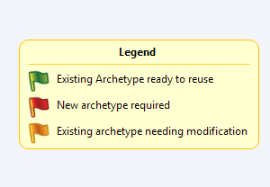
RMP On-call Archetype Re-use
Re-use of existing | 16 | 50% re-used, no changes | 59% re-use
Modify existing – minor | 2 | 9% re-used with some enhancements from newly identified requirements
Modify existing – major | 1
New development | 13 |  | 41% new
Notes:
Simple stats on archetype re-use based on the mindmap requirements

Slide 35
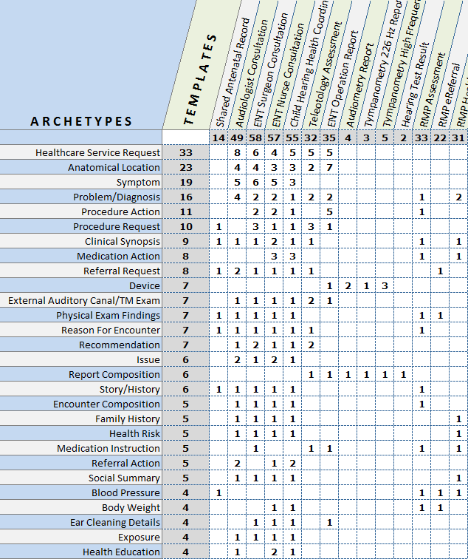
Northern Territory Re-use
14 unique templates
1 Antenatal
10 Hearing Health
3 RMP on-call
400 instances of 81 unique archetypes
Number of archetypes per template: 2…58
Number of times an archetype is used across all templates: 1…33
Notes:
Analysis of all the current archetypes being used across all 3 projects in the NT subdomain as they are used in NT templates. The templates are listed across the top, the archetypes down the side.
The numbers in the main, white area represent the archetype use per template.
The numbers in the grey horizontal column at the top represent the total number of archetypes per template ie 14 archetypes are used in the Shared Antenatal Record, 49 in the Audiologist Consultation etc.
The numbers in the grey second column represent the number of times an archetype is reused across all of the templates.

Slide 36
IT’S. ALL. ABOUT. THE. DATA.
Change the viewpoint
Data (UHR) vs Application or Message
Break down silos - App/Tech/Vendor independent
Active health information sharing
Life-long cohesive health record
Change the approach
Clinician-driven+++
Express clinical variability via templates, based on tightly governed archetypes
Sustainable Re-use

Slide 37
THANKYOU
www.openEHR.org
International CKM – www.openEHR.org/ckm
Australian CKM - http://dcm.nehta.org.au/ckm/
UK CKM - http://www.clinicalmodels.org.uk/ckm/
Brazil
?Slovenia
?Norway

